Slide 1
Raising of livestock
Balancing Productivity and Sustainability

Slide 2
1. About this module
2. Introduction to raising of livestock
CONTENTS
3. Livestock farming practices
4. Treatment and health of animals
5. Ethical and human treatment
6. Sustainable farming and the “future” of livestock
7. Insect farming: potential and challenges
8. Exercise

Slide 3
About this module
What are you going to find here?
Brief introduction to the concept of animal husbandry
Different types of livestock and their main characteristics.
Differences between extensive and intensive livestock farming
The importance of healthy livestock and ethics in animal husbandry.
Sustainable farming: present methodologies and future perspectives.
Insect farming as an alternative to current livestock habits.

Slide 4
Introduction to livestock farming
The process of raising and breeding animals to obtain:
Products such as wool and other fibers
Dairy products and eggs
Labor
Food
As of now, livestock farming accounts for a significant portion of the global food supply and workforce in the agricultural sector.
Despite the importance it holds, it’s ecological footprint is substantial, bringing many individuals and communities to research and implement new methodologies.

Slide 5
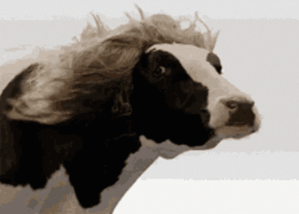


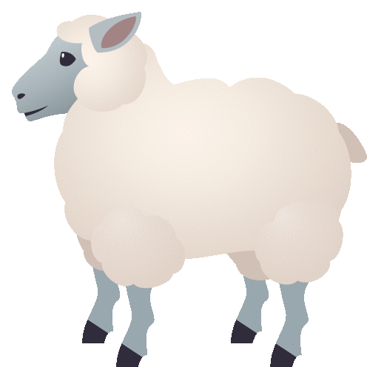
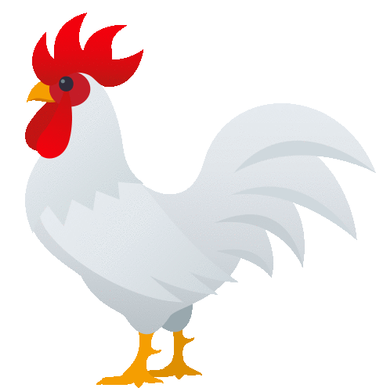
Main types of Livestock
Cattle
Swine
Sheeps
Poultry
Breeding of cows and bulls for the production of meats, dairy products and leathers.
It requires big spaces and has the biggest ecological footprint out of all the different types of livestock.
Breeding of pigs almost solely for the production of meats.
Requires less space than cattle and has a slightly minor ecological impact
Sheeps are bred for the production of mostly milk and different kinds of wool, along with their meat.
Consists mostly of chickens for their regular production of eggs and their meat.
Their impact on the environment is significantly lower than the other types of livestock

Slide 6
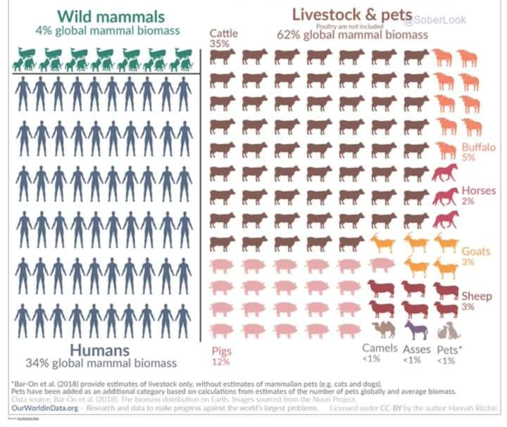
Mammals
on Earth

Slide 7
Livestock Farming Practices
Farming of livestock is mainly carried out through two means: intensive and extensive farming.
Intensive farming refers to the practices that optimize the space employed, but it comes with major drawbacks to the treatment and quality of life of the animals.
Extensive farming is aimed at providing the animals the spaces that the would naturally need. It is by far more space consuming but also more humane and usually leads to a higher quality of the products (at all levels).

Slide 8
Treatment of animals and their health
Stress
Over their lifetime, livestock are subject to different factors that influence their wellbeing
Genetic problems
Extreme temperatures and weather
Dental problems
Infective diseases
Parasites
Nutrition
Poor management of these aspects will impact the quality of the products, and most importantly will greatly worsen the quality of life of the animals.

Slide 9
Ethical and human treatment
Regardless of your stance on meat-eating, we have to make sure that the animals are treated with respect and as humanly as possible.
To do so, we have to make sure that they are being followed by vets and professionals in animal care, and that each animal has the space that it needs to live comfortably.
Lean towards extensive farming practices rather than intensive ones, and avoid at all costs practices that are not ethical and humane (debeaking, bad treatment, etc.).

Slide 10
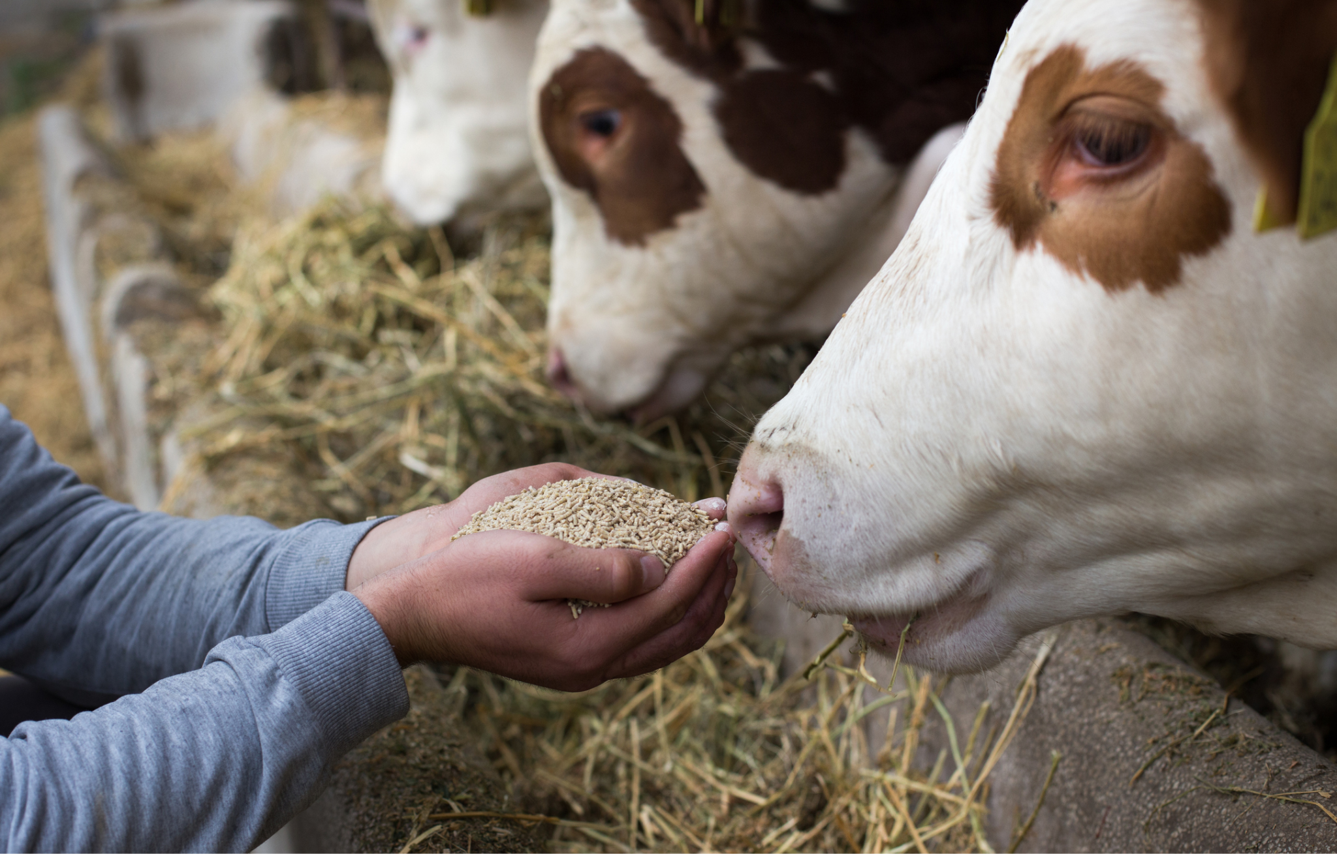
Feeding the animals
The quality of food that an animal consumes
highly impacts the quality of their lives,
along with those of their products.
Moreover, the production of livestock food
has a great impact on the environment.
Leaning towards sustainable and healthier choices in feeds is a conscious choice that benefits every link of the chain, from the animal itself to the consumers.
Avoid at all cost the employment of practices such as overfeeding, which are exclusively aimed at making bigger profits while damaging the life of the animals and those of the consumers of your products.

Slide 11
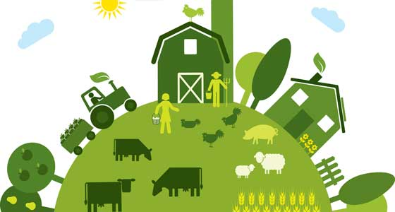
Sustainable farming: how can we improve?
Sustainability in livestock farming is
mostly linked to the treatment of the
animals and the limitation of their
impact on the environment.
Use of organic feed, rotational grazing,
and ethical treatment of animals are just
some of the practices that are currently
being employed recently in the field.
It is a common belief that the only way to significantly impact the ethical and ecological aspect of livestock farming is to reduce considerably the consume of its products (especially their meat).
© ift.org

Slide 12
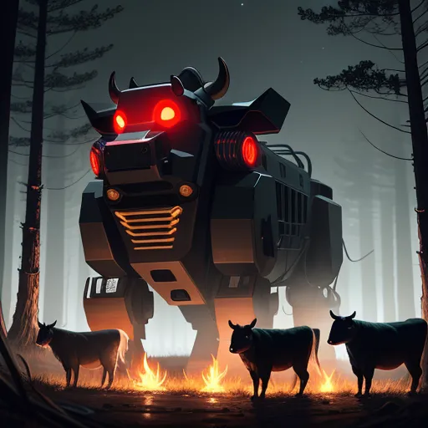
The present and future of livestock farming
It is becoming more common for newer technologies to be integrated in livestock farming.
Some of these modern practices include:
Precision livestock farming
Integration of robots
Genetic selection of stronger breeds
Formulation of nutriment
Biometric Sensors for Health Monitoring
Weaponized cows for mass destruction
© storybird.ai

Slide 13
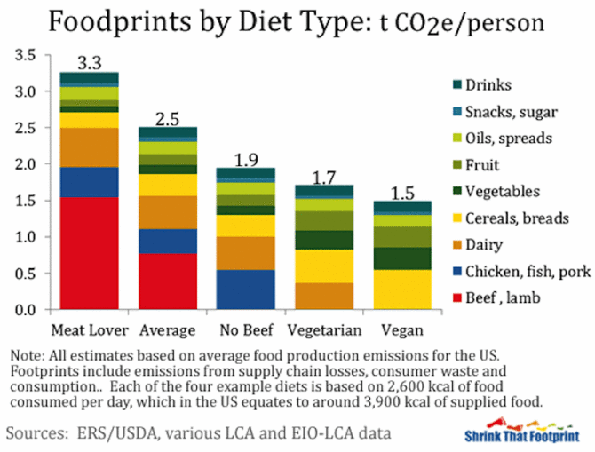
Foodprint by diet type: t CO2e/person

Slide 14
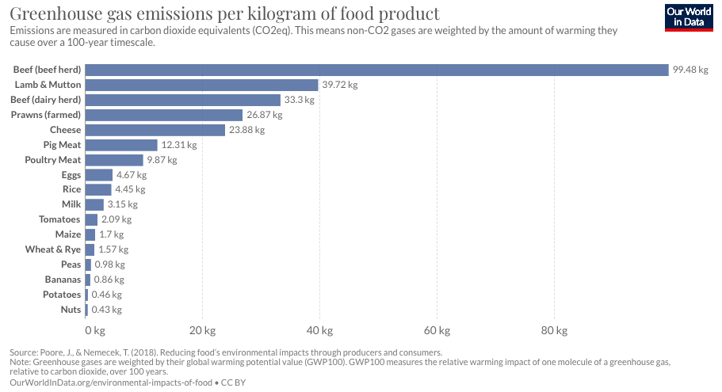

Slide 15

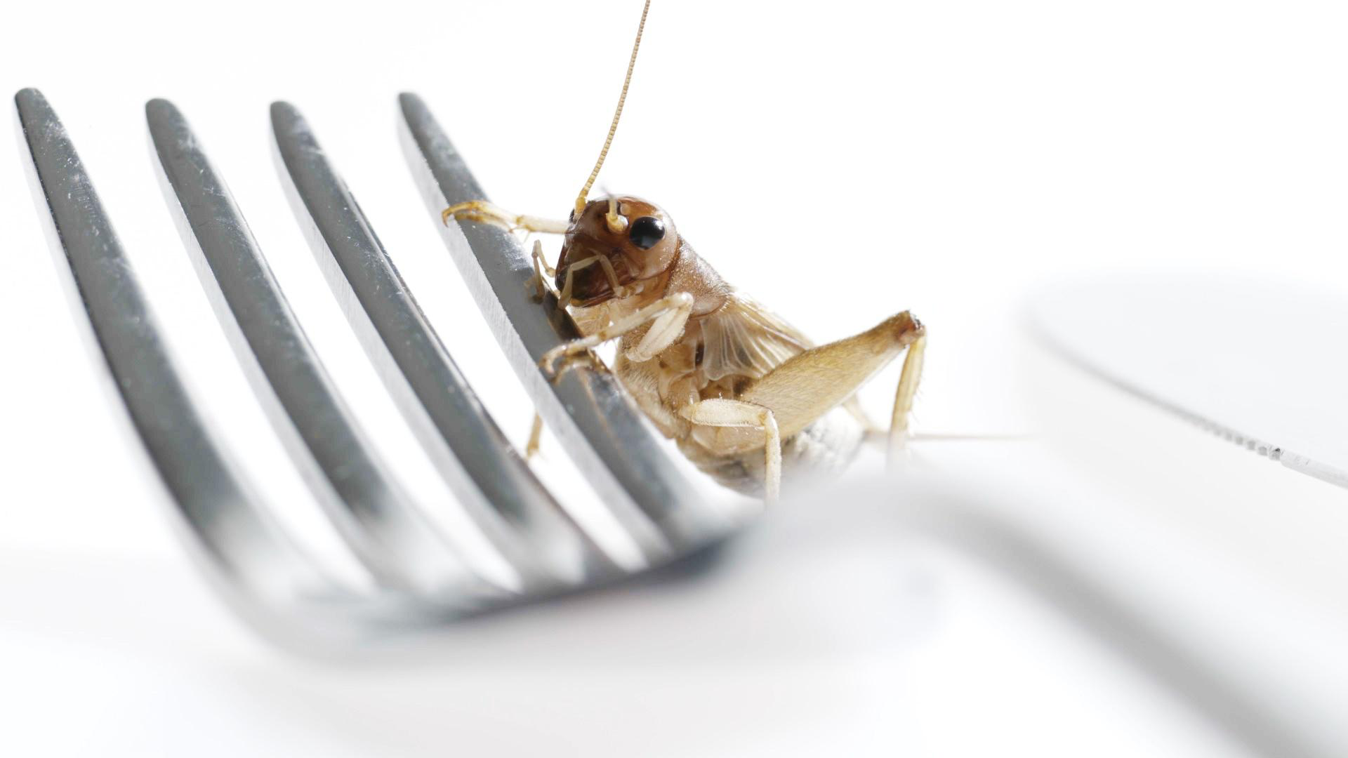
Could one solution be…
Video
Why eating insects makes sense The Economist euTBQOrpOmM

Slide 16
Insect farming: a new frontier in livestock farming?
Insect farming is seeing more and more attention globally.
Embarking now in a insect farm project could be a great way to stay ahead of the curve, but will come with challenges and risks.
High nutritional value
More sustainable than most “traditional” counterparts
Possibility for recycling organic waste
Less space needed
Has yet to be culturally accepted in many realities
Only few species can be cultivated for now
Legal framework is still unstable

Slide 17
Activity n°1- Where do you stand?
Materials needed:
2 signs indicating “Agree” and “Disagree”
Tape (optional) to draw a line in the floor
Space for people to move about
Aim
In this discussion activity participants literally stand up for their opinions.
Method and explanation:
Have all the participants gather in circle either standing or seating.
The facilitator should come up with a series of statements starting with 'Where do you stand if …” There is a list of statements in the next slide. Feel free to adapt and remove/add new ones as you see fit.
After each statement, participants should move to one side of the circle if they agree with the statement or the other side if they disagree or remain neutral based on their preferences
Encourage participants to share their reasons for standing on a particular side of the circle. This can spark conversation and help people get to know each other better.
After several rounds, conclude the activity and encourage the participants to reflect on the discussion.

Slide 18
Statements
I am not interested in sustainability, I just want to live my life.
We cannot change the current livestock practices – sustainable livestock farming is very expensive.
Livestock farming can ensure ethical treatment of animals while meeting the demands of sustainable production.
We do not need to lower our meat consumption: science will find a solution for sources available on a mass scale.
Vegans are just a trend that will fade over in the near future.
I am open to alternative protein options in my diet.
I would eat insects.
In the next 50 years, the humankind will switch to a more plant-based diet.

Slide 19
Thank you for the attention!

