Slide 1
Module 3: Sustainable
methodologies and practices
Cultivating Sustainability: Methods and practices in the modern agriculture

Slide 2
1. About this module
2. Introduction to sustainability
CONTENTS
3. Potential for innovation in sustainable agriculture
4. Methods
5. Practices
6. Financing a sustainable business in agriculture
7. Exercise

Slide 3
About this module
What are you going to find here?
Definitions of sustainability and what are the defining aspects of a sustainable practice
Potential of sustainable agriculture in modern world
Different examples of sustainable methodologies and practices
How to finance a sustainable business in agriculture
Dynamics, information, and resources related to sustainability.

Slide 4
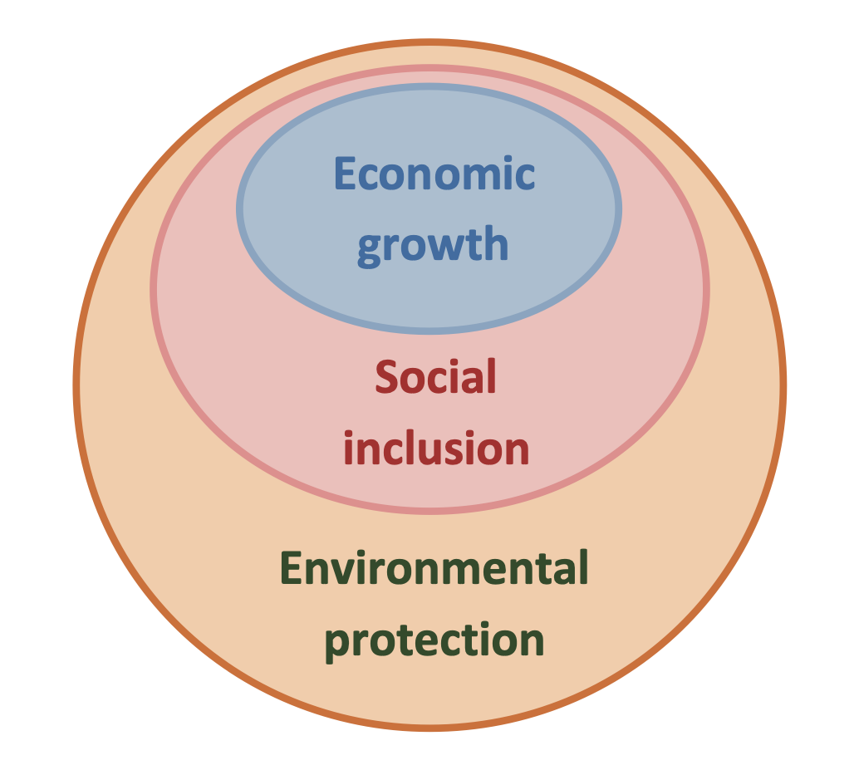
Sustainability?
Sustainability refers to the capacity of any activity to meet the demands of the present without jeopardizing the right of following generation to meet their own needs.
This is mostly done by actively seeking three different kinds of sustainability:
Economic;
Social;
Environmental.
Fig. Dimensions of sustainable development

Slide 5
Economic sustainability
Perhaps the first example that comes to mind when dealing with sustainability, analyses of economic sustainability are mainly done to ensure that the business choices made are financially viable in the long run.
Other that aspects that are strictly within the boundaries of the enterprise itself, this aspect also concerns aspects such as the promotion of the development of local economies and communities.

Slide 6
Social Sustainability
This aspects ensures that initiatives and business choices are made while recognizing the importance of social justice and equity.
In order to to do, businesses should ensure fair treatment and equal opportunities to all the individuals involved, regardless of factors such as race, gender, age or socioeconomic status.
By upholding to this principle, businesses can work together with communities in order to build and foster inclusive professional and social environments.

Slide 7
Environmental Sustainability
Sustainable practices prioritize the health of the planet by minimizing the negative impact of human activities on ecosystems.
This aspect involves practices that are aimed towards the conservation and protection of biodiversity, the reduction of pollutants, and the promotion of efficient use of natural resources such as water, energy and land.

Slide 8
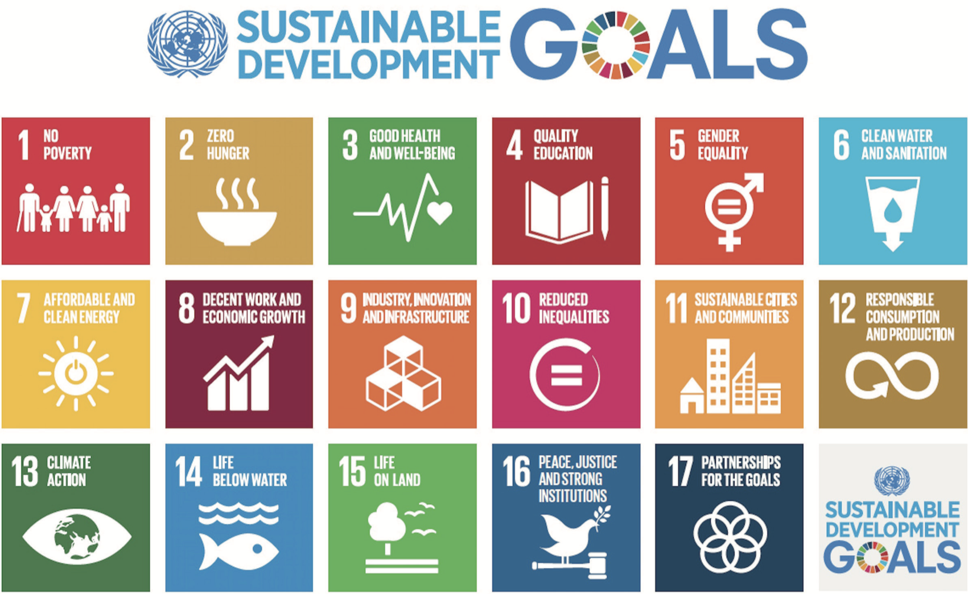
Source: United Nations

Slide 9

Potential for innovation in sustainable agriculture
The application for innovative technologies and practices in agriculture is vast and variegated, with possibility for integration in every step of the process.
The potential is limitless, but we need to continue investing in research and in the areas of development of new approaches and methodologies.
© ecomatcher.com

Slide 10
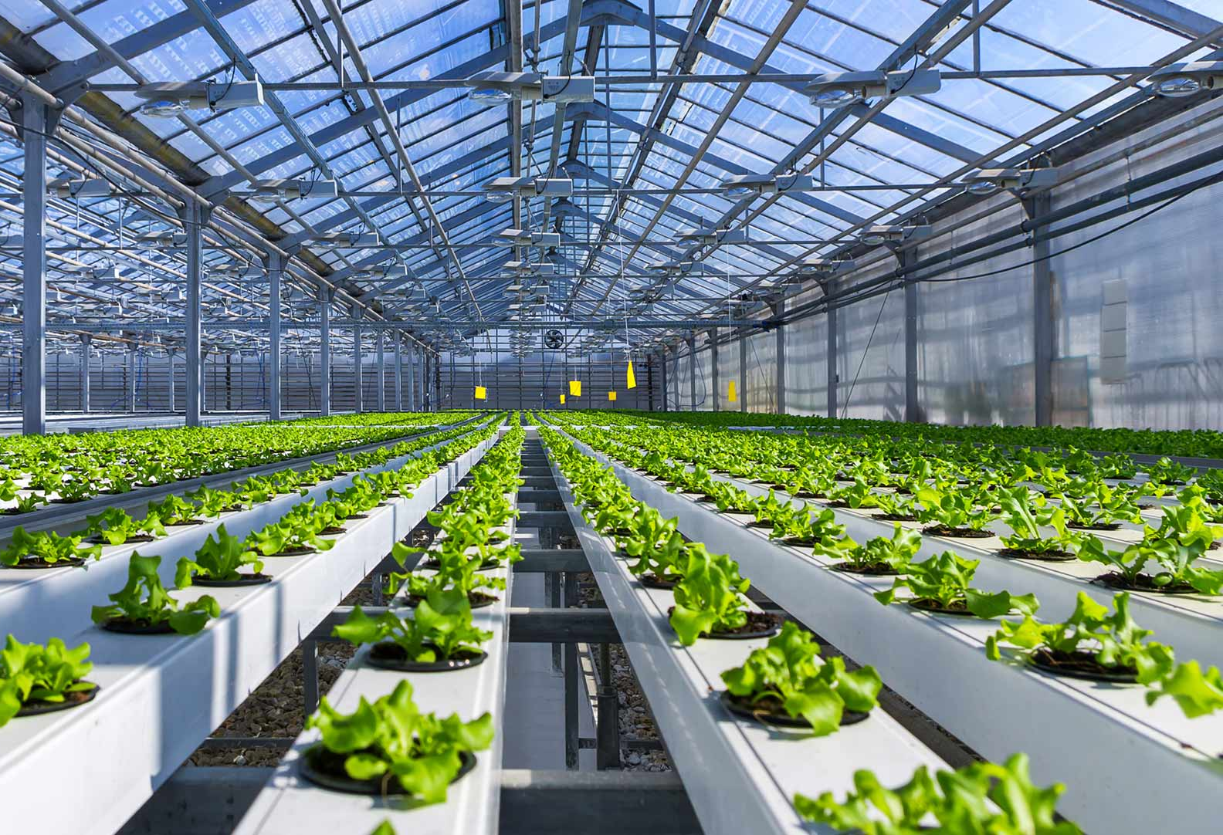
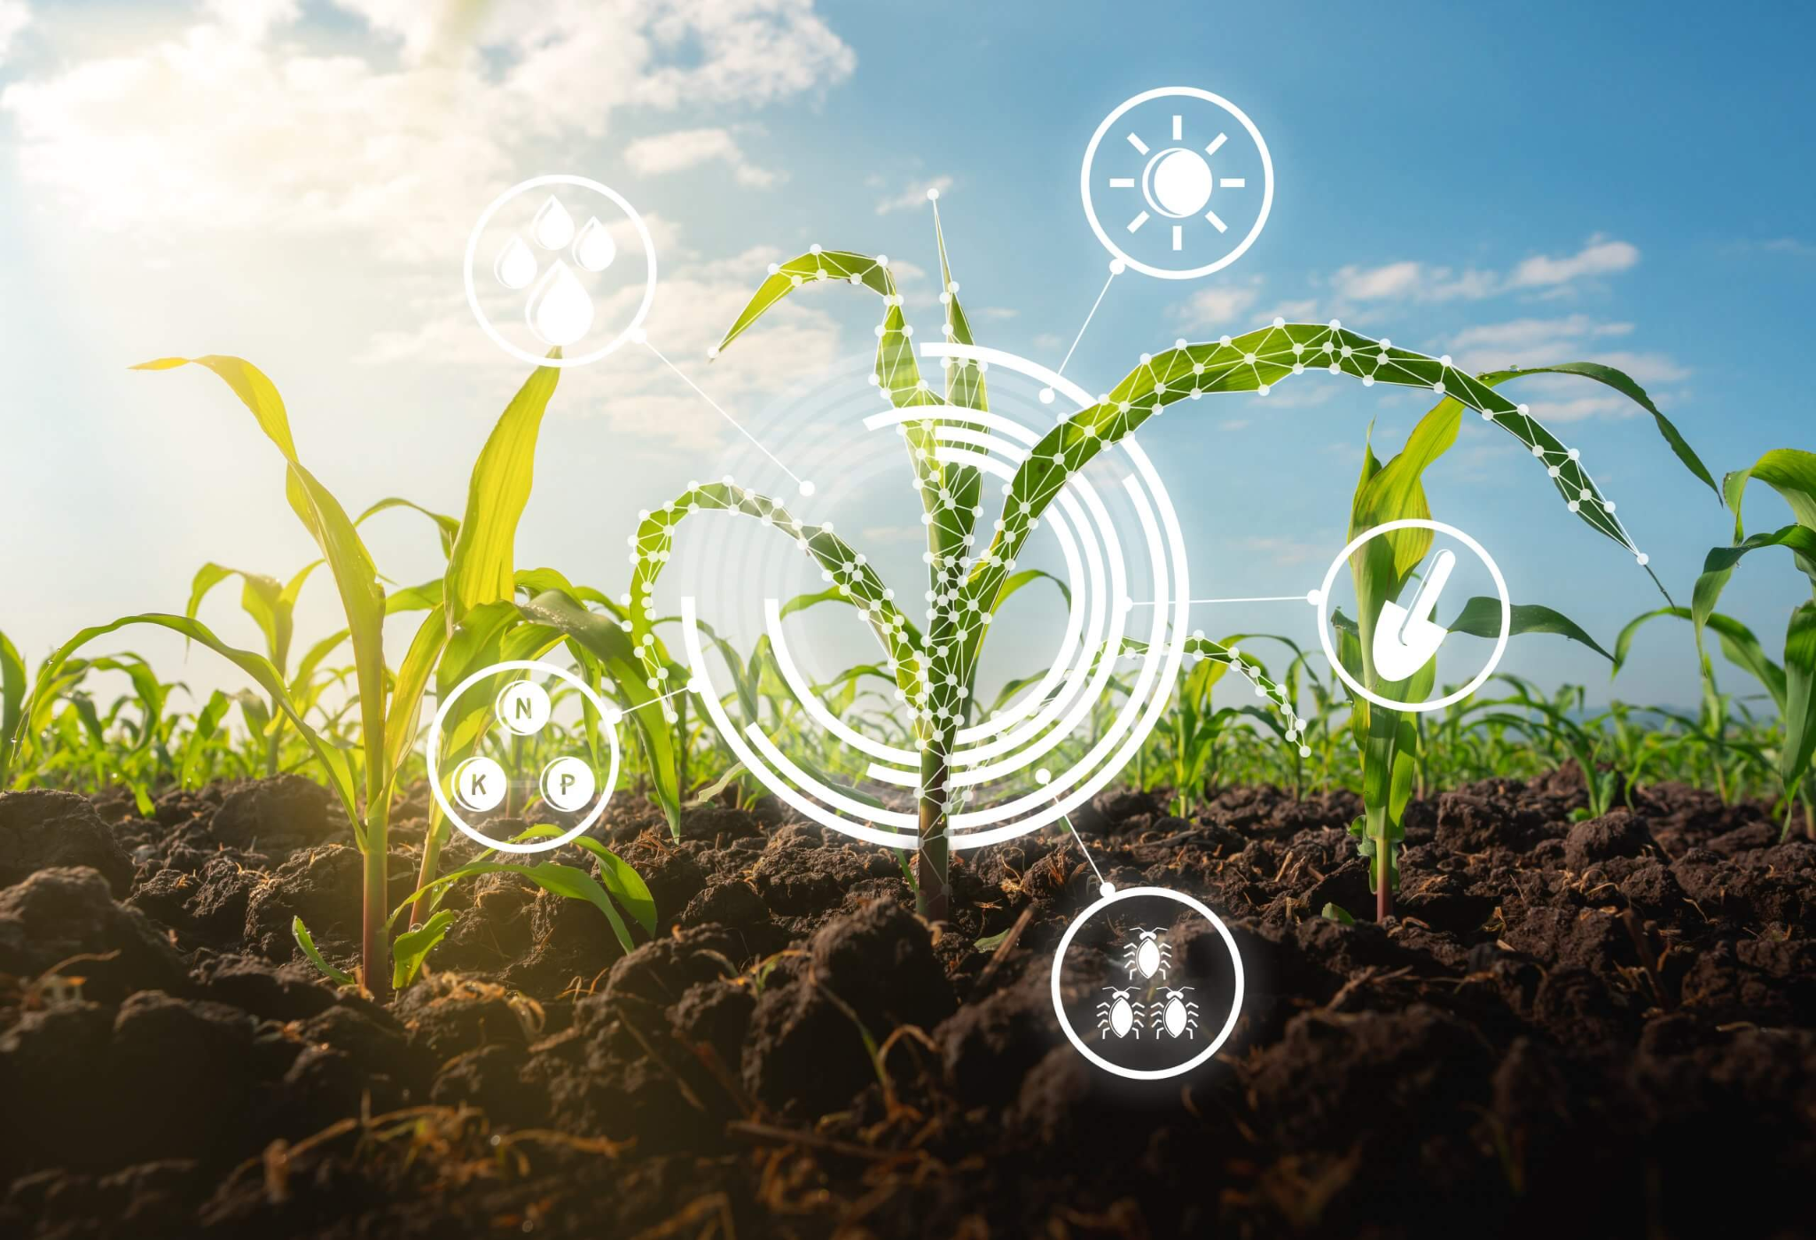
How about some examples?
©fyouture.fund
©nhti.edu

Slide 11
Just to name a few!
Circular agriculture
Precision agriculture
Sustainable agriculture
Agroecology
Bioengineering
Vertical farming
Hydroponics/Aeroponics

Slide 12
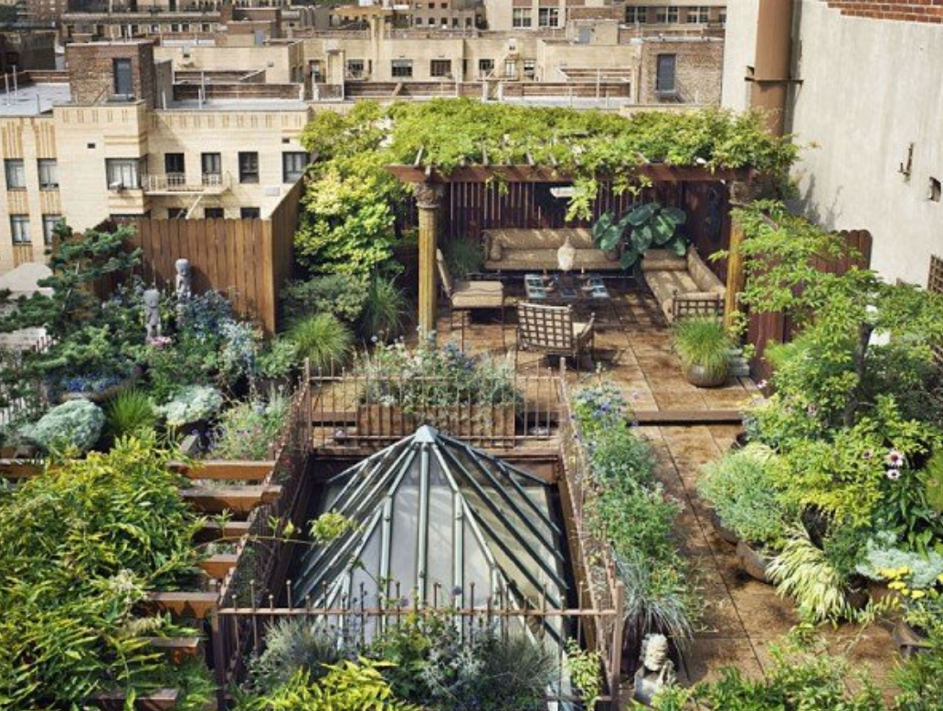
Methods: Permaculture
A design system that aims at integrating harmonically human environments with nature and its products.
It’s based on ethical principles aimed at safekeeping humans and nature in all its form, such as :
Reduction of waste
Usage of renewable resources
Embracing natural patterns and rhythms
© signaturesustainability.com

Slide 13
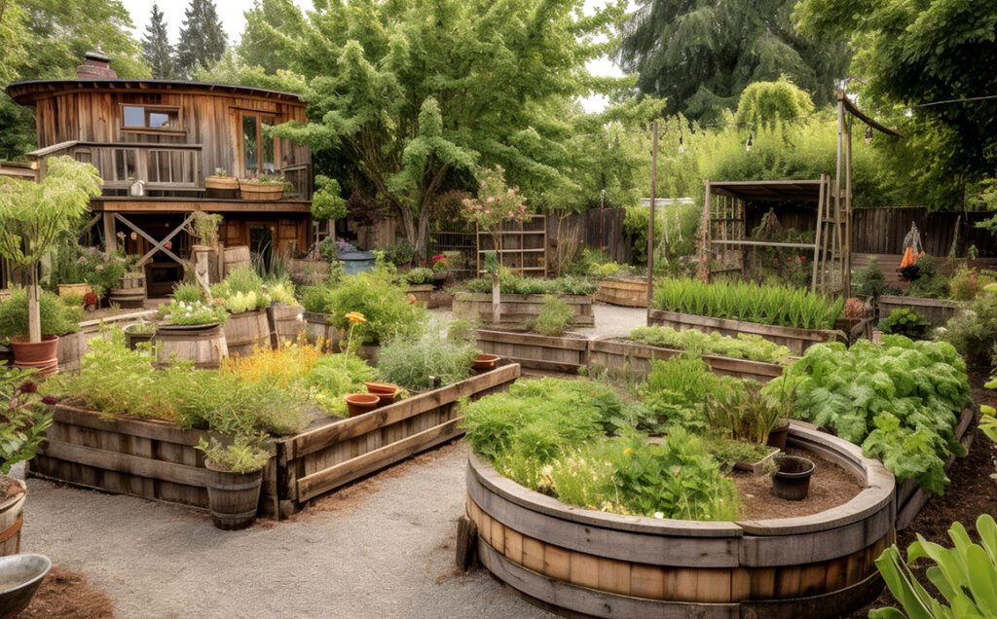
Method: Permaculture
This methodology minimizes ecological impact of human activities by promoting awareness of urbanization’s footprint.
This approach is best suited in rural and suburban areas, but it’s seeing application in the development of more green-oriented urban areas.

Slide 14
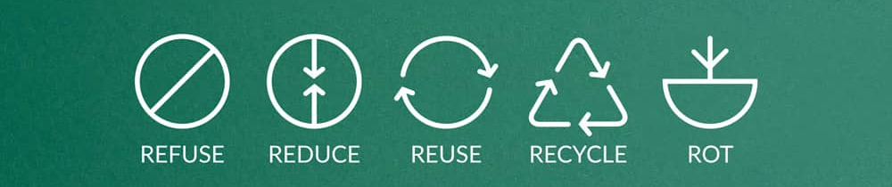
Methods: Zero Waste
Development of productive cycles and lifestyles that are aimed at the reduction (ideally to zero) of the waste produced in the process.
This objective is sought in two main ways:
This methodology is perfectly suited to be employed in agriculture, especially in smaller realities and enterprises.
Repurposing of byproducts (such as using materials that are not suitable for human consumption to feed livestock)
Eliminating the source of the byproducts that cannot be otherwise used.
© teby.it

Slide 15
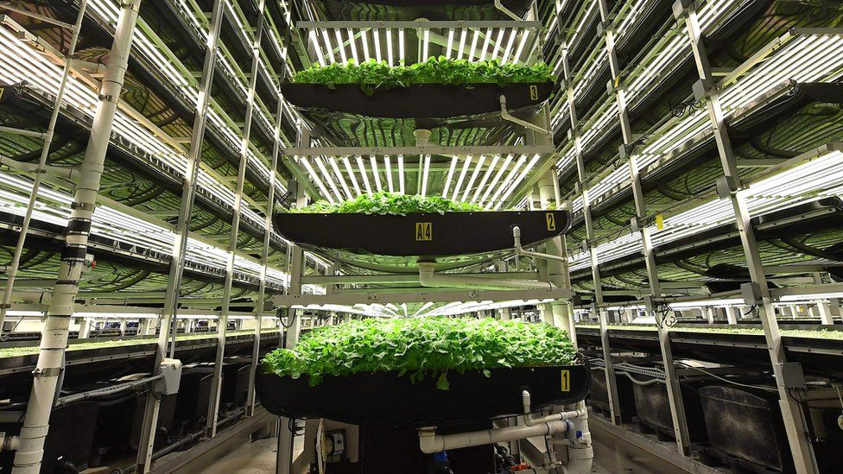
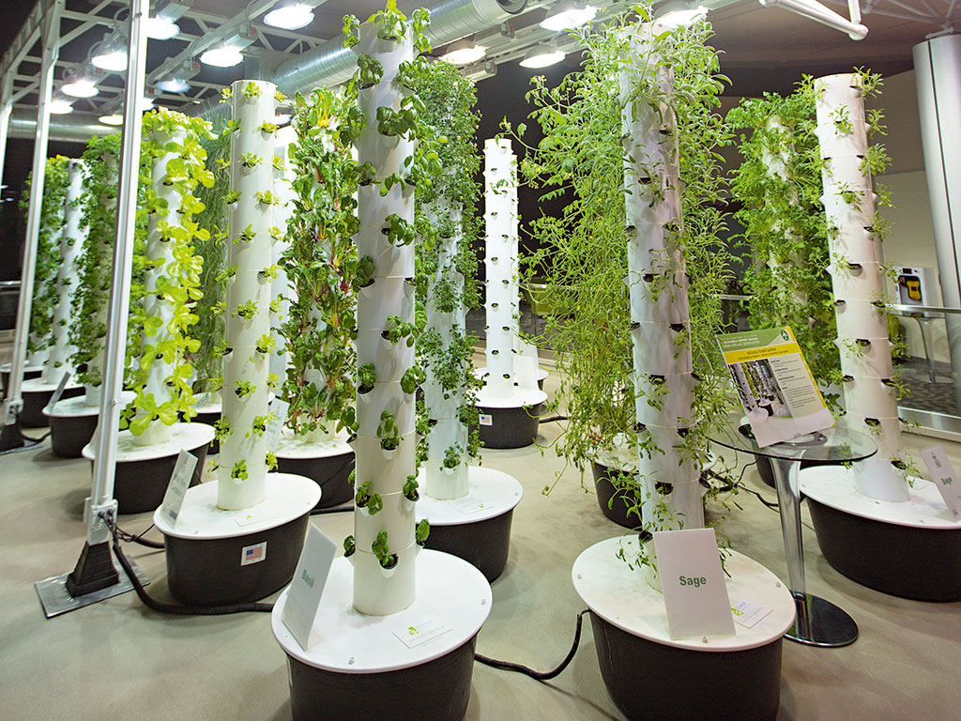
Methods: Vertical farming and
hydroponics
© bbc.com
A methodology that integrates crops farming
with cutting edge technologies to drastically
reduce the space required for mass cultivation.
Plants are cultivated in vertical structures with
little to no soil usage and with up to 80% less
water consumption.
Light can be provided by natural sources of through
special lamplights.
© theneweconomy.com

Slide 16
Vertical farming and hydroponics:
some pros & cons
Possibility to extend the periods for cultivation
Reduction of soil and water usage
Increased growth rates
Initial setup costs are much higher that traditional farming
Dependent on a reliable power supply
Limited selection of crops that are suitable to be cultivated this way

Slide 17
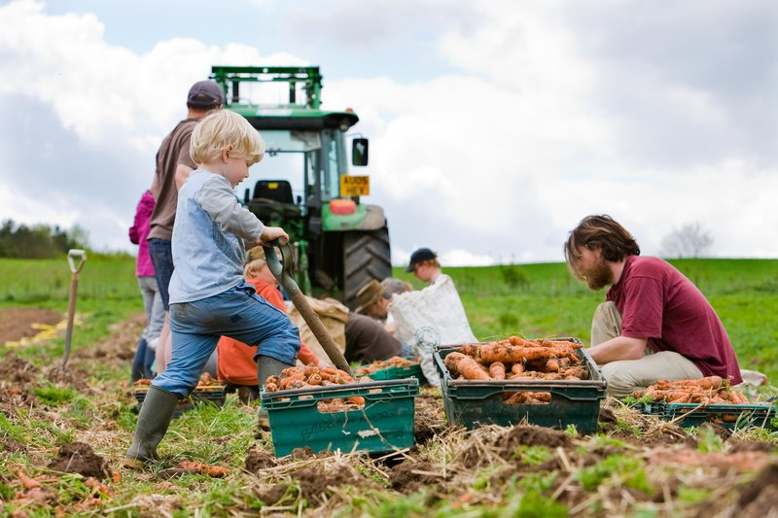
Practices: Community supported agriculture
A practice that is centered on a locally based and collaborative approach to farming by promoting active participation in a community with shared responsibilities.
This model often emphasizes sustainable and organic farming practices, local food economies, and community engagement, contributing to both social and environmental well-being.
© sustainweb.org

Slide 18
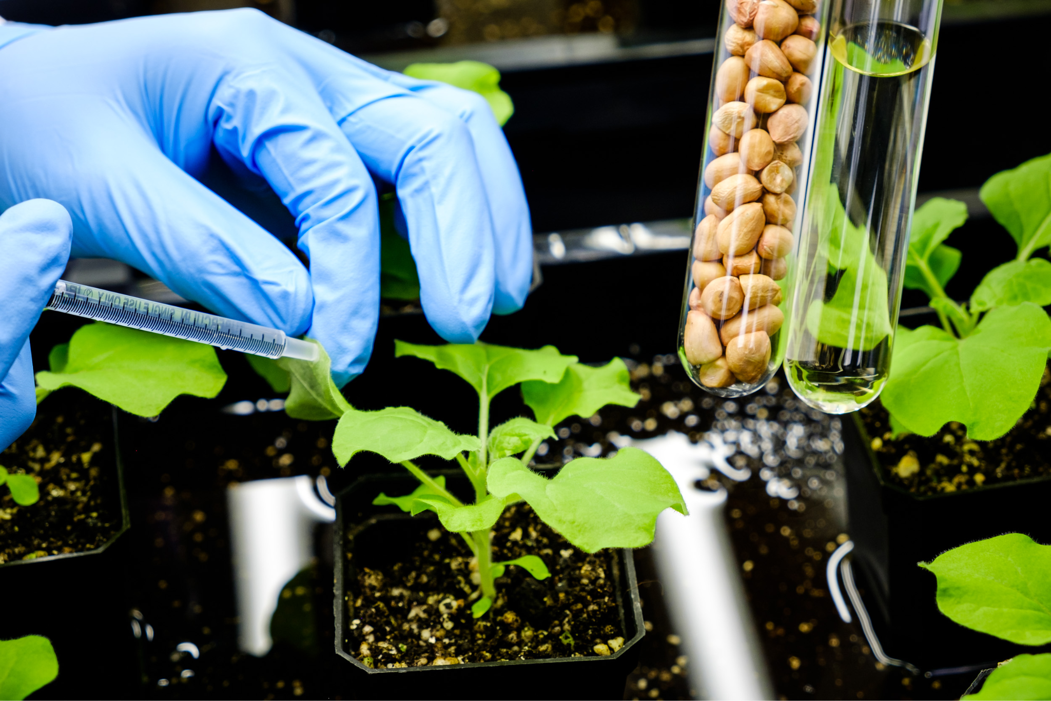
Practices: Bioengineering
Based on the development of new species of crops that can better suit the needs of farmers and consumers.
By creating new species, we can isolate the characteristics that we need (such as resistance to diseases and pests, bigger harvests, resistance to adverse meteorological conditions), while at the same time removing the undesirable ones.
© Nanyang Technological University, Singapore

Slide 19
Bioengineering: some pros & cons
increased crop yields
optimization of nutritional values
environmental sustainability (less usage of fertilizers and pesticides for example)
“stronger” artificial plants could overtake other species reducing biodiversity;
limitation in farmers’ choices of crops
GMOs are actively opposed by many people, which see that as dangerous or unethical
Making a conscious choice balanced on these factor is the key to a profitable and sustainable employment of this practice in modern agriculture

Slide 20
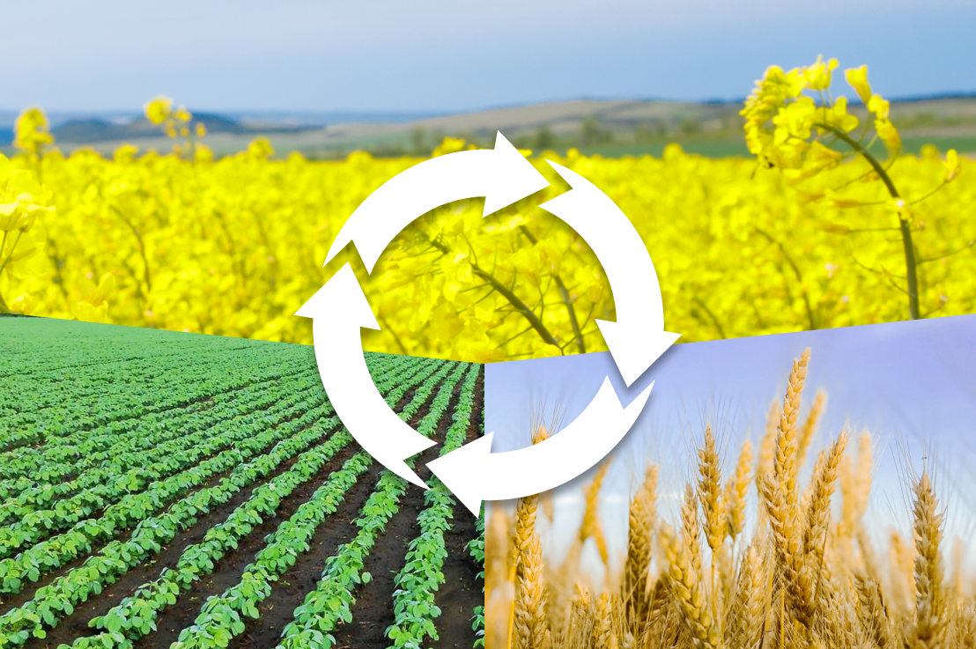
Practices: Crops rotations
© blog.fieldmargin.com
An ancient method that consists on the rotation of different types of crops in the same field over the years, capitalizing on the specific characteristics of each.
Enhanced crop yield
Pests and diseases management
Soil health
Improved nutrient balance in the soil.
Decreases the buildup of specific pathogens in the soil.
Breaks the life cycle of pests and diseases.
Reduction in soil erosion.
Different crops have different nutrient requirements, preventing depletion of specific nutrients.
Improved overall productivity.

Slide 21

Financing a sustainable business in agriculture
Farms which actively employ one or more sustainable methodologies and practices are also more likely to be eligible for grants and external fundings from national and international sources.
Consider the possibility for application to calls for proposals that could funnel more financial resources in your ideas.
© jeffbullas.com

Slide 22
Exercise- Research and analyze
Researching and analysing sustainable agriculture models
Material needed:
Flip Charts and Markers
Digital device to do the research
Internet Connections
*** For an online version, invite participants to use digital presentation tools.
Aim
To teach, foster reflection, and inspire motivation regarding sustainable agricultural practices. Through research and discussions, participants will gain comprehensive insights into the principles, benefits, and concrete examples of sustainable agriculture, empowering them to make informed choices and contribute positively to environmental conservation and food security.
Method and explanation:
Ask participants to research about sustainable agriculture practices that inspire them.
Give them 30 minutes to analyse a single practice, identifying its strengths, added value and potential challenges/ difficulties it presents..
Ask everyone to prepare a presentation and after to share their work with the rest of the group.
At the end of the presentations, run a short debriefing asking the participants about the activity.

Slide 23
Thank you for the attention!

