Slide 1
Matching Needs with competences!
PROGRAMME ERASMUS+
Project ID KA220-YOU-37C49185
Cooperation partnerships in youth Form

Slide 2
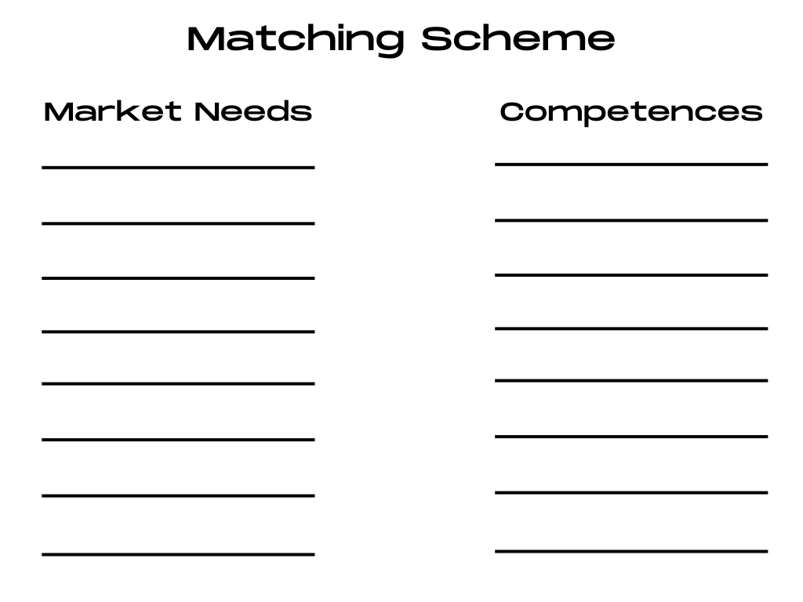

Slide 3
Thank you for the attention!

