Slide 1
HOW TO CREATE A VIDEO PITCH?
PROGRAMME ERASMUS+
Project ID KA220-YOU-37C49185
Cooperation partnerships in youth Form

Slide 2

STEP BY STEP HOW TO CREATE YOUR BUSINESS PITCH VIDEO?
Step 1: before the video shooting
Storyboard your pitch video
Creating a storyboard is one of the most important steps in making your video pitch. This will be a visual guide that will help you determine what shots you need, as well as the sequence of your video.
When making your storyboard, keep the following in mind:
Your pitch should have a beginning, middle, and end
Each scene should have a specific purpose

Slide 3

STEP BY STEP HOW TO CREATE YOUR BUSINESS PITCH VIDEO?
Script your video
Once you have your storyboard created, it’s time to start writing your script. This is where you’ll determine what exactly you’ll be saying in each scene.
When writing your script, keep the following in mind:
Your pitch should be clear and concise.
You should avoid using industry jargon.
Your pitch should tell a story.

Slide 4

STEP BY STEP HOW TO CREATE YOUR BUSINESS PITCH VIDEO?
Step 2: during the video
Tell your story
The opening few seconds should start with a greeting, then your name, your job in the startup, the startup's name, and the problem the startup is trying to solve.
For example, "Hey, I'm CEO of AgroThink startup, Antony Heathway." For those who are too busy to shop for food, we deliver groceries.
Here is where you should develop your distinctive value proposition. There are countless goods and services available. What makes you unique? Having a distinctive value proposition will make you stand out from the competition.

Slide 5

STEP BY STEP HOW TO CREATE YOUR BUSINESS PITCH VIDEO?
Define the problem
Inform the audience of the difficulties you had and your realization that many others are in similar situations makes you want to propose a solution. They ought to be able to comprehend from your explanations why the issue arises and why a quicker solution is required.

Slide 6

STEP BY STEP HOW TO CREATE YOUR BUSINESS PITCH VIDEO?
Back up your claims
Use statistics to support your explanation of the solution to get the viewers' attention. Make sure the data explains to them the rationale behind your company's existence and the superiority of your proposed solution.
Do not forget to add the following details:
The potential market
Your future objectives

Slide 7

Essential elements of a pitch video…
Problem
Solution
Product
Product-Market fit
Notes:
PROBLEM: The pitch video should start by highlighting the problem that the startup is trying to solve. It should be clear and concise, and the founders should explain why this problem is worth solving. The video should demonstrate that the problem is significant and that it affects a large number of people. By explaining the problem, the founders can grab the investors' attention and make them interested in the solution.
SOLUTION: After explaining the problem, the pitch video should introduce the solution that the startup is offering. The solution should be innovative and unique, and the video should explain how it solves the problem. It should also highlight the benefits of the solution and how it can make a difference in people's lives. The founders should also explain why their solution is better than the existing solutions in the market.
PRODUCT: The pitch video should showcase the product and explain how it works. The founders should demonstrate the product's features and how it can solve the problem. They should also highlight the product's uniqueness and how it stands out in the market. The video should also explain how the product can be scaled and how it can generate revenue.
PRODUCT-MARKET FIT: The pitch video should demonstrate the startup's product-market fit and how it has identified its target audience. The founders should explain how they have validated their solution with their target audience and how they have received feedback. They should also highlight how they plan to expand their reach and how they can cater to different customer segments.

Slide 8

The 3 Why’s
Why this problem?
Why this solution?
Why this team?

Slide 9

EXAMPLES
Organic Delights
Niche: Organic Farm-to-Table Delivery
Slide 1 – The Problem: Growing demand for organic foods, but limited access and freshness in urban areas.
Slide 2 – Our Solution: Directly sourced organic produce, delivered to your doorstep within 24 hours of harvest.
Slide 3 – Market Opportunity: Citing studies showing a surge in organic food consumption and the farm-to-table movement.
Slide 4 – Business Model: Subscription boxes with different sizes and customization options.
Slide 5 – Traction: Over 3,000 active subscribers and partnerships with 50+ local organic farms.

Slide 10
EXAMPLES
AquaPure Solutions
Niche: Sustainable Aquaponics Farming Systems
Slide 1 – The Problem: Overfishing and unsustainable farming practices depleting resources and harming ecosystems.
Slide 2 – Our Solution: Integrated aquaponics systems for sustainable fish and vegetable farming.
Slide 3 – Market Opportunity: Data showcasing the dwindling fish supply and growing demand for eco-friendly farming solutions.
Slide 4 – Business Model: Sale of aquaponics setups, training programs, and consultancy.
Slide 5 – Traction: 200+ setups installed, with 5 training programs conducted across the country.

Slide 11
EXAMPLES
FarmBuddy: Drone-Assisted Crop Management
Slide 1 – Introduction: A serene image of a vast farmland with a drone hovering above, captioned, “The Future of Farming.”
Slide 2 – The Problem: Split-screen showing a farmer toiling hard in one half, and an unattended, wilting crop in the other.
Slide 3 – Our Solution: Video clip of FarmBuddy drone surveying fields, analyzing soil, and performing basic tasks.
Slide 4 – Market Potential: Graphs indicating the exponential rise in tech adoption in agriculture.
Slide 5 – Unique Selling Proposition: Icons showcasing real-time data analysis, automated crop management, and reduced labor costs.
Slide 6 – Testimonials: Quotes from prototype testers and initial investors.

Slide 12
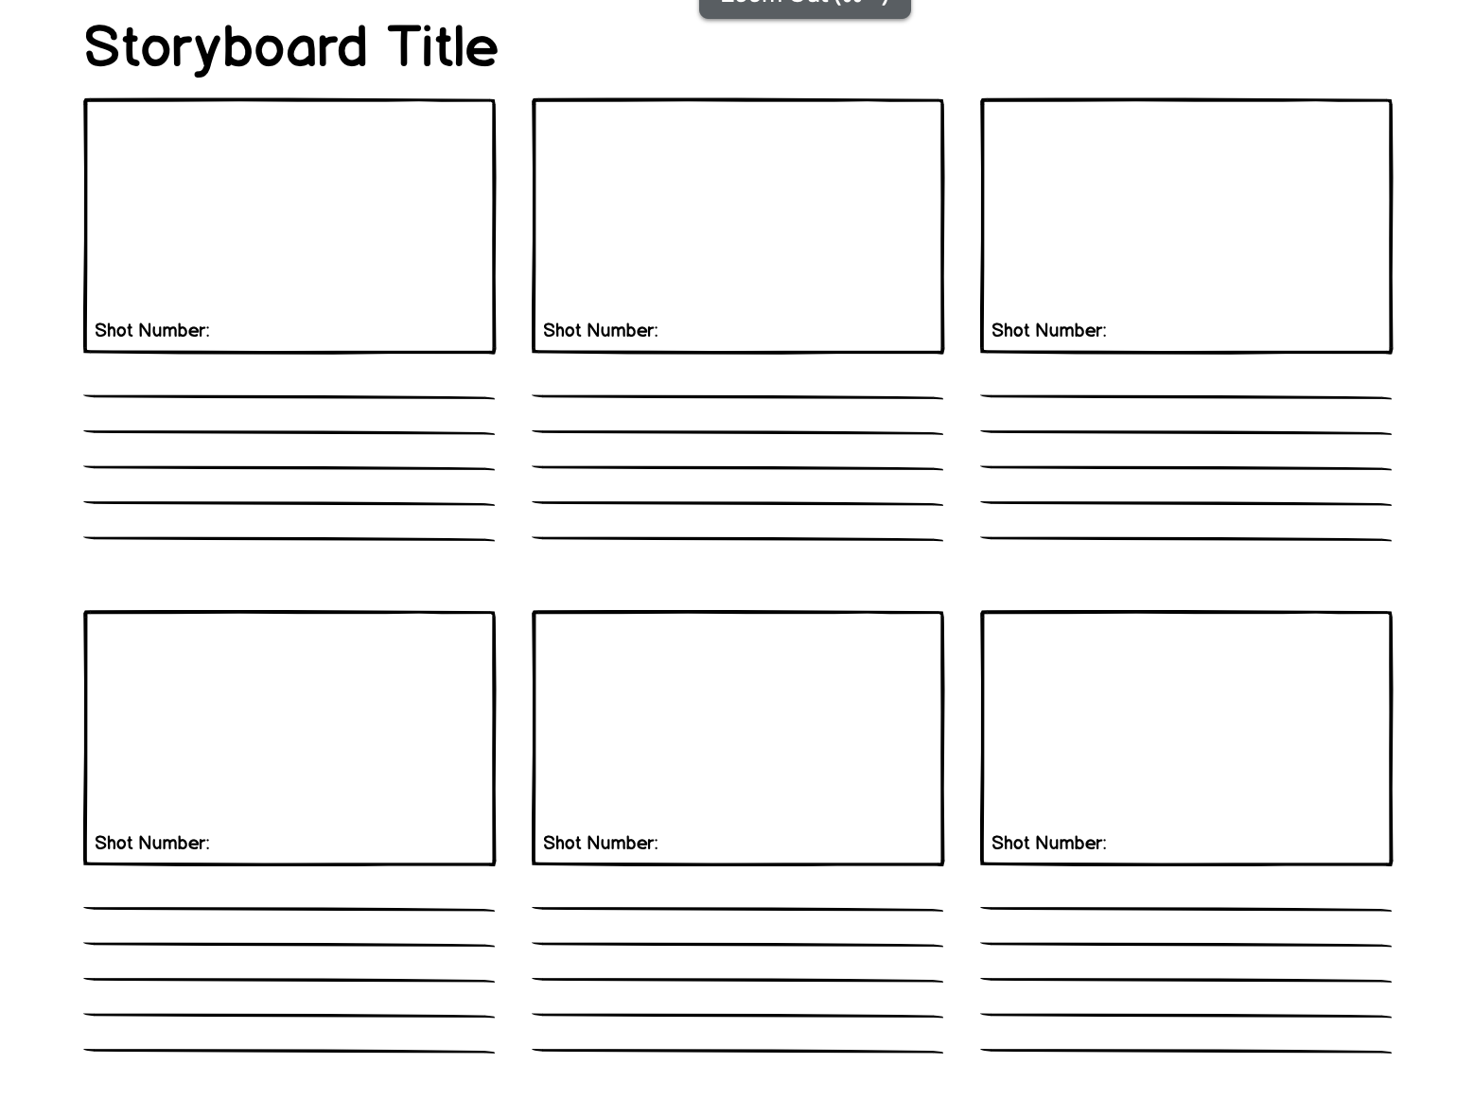
STORYBOARD SAMPLE

Slide 13

VIDEO EDITING SOURCES
https://inshot.com/
https://capcut.com/
https://kinemaster.com/

Slide 14
References:
https://www.pitchdrive.com/academy/tips-guide-effective-investor-pitch-video-startup
https://www.editmate.com/how-to-make-a-business-pitch-video-for-your-startup/
https://viktori.co/agriculture-pitch-deck-presentation-guide/

Slide 15

NOW YOU CAN FINALLY START WITH YOUR VIDEO PITCH OF 60 SECONDS!
GOOD LUCK!

Slide 16
Thank you for the attention!

