Slide 1
The internship
Attitude, expectations and safety rules
PROGRAMME ERASMUS+
Project ID KA220-YOU-37C49185
Cooperation partnerships in youth Form

Slide 2
Attitude
During your internship, you must above all behave in a respectful and professional manner.
Your internship supervisor is willing to give up his or her time, sometimes very precious, and energy, to welcome you, help you discover his or her world and give you the best possible training.
You'll be entering his world, with social codes, ways of working, language and habits that are sometimes very different from what you're used to. You owe it to yourself to respect these differences, not to jeer at them, and even less to criticize them.

Slide 3
Attitude
Respect for privacy and the company:
You may see or hear sensitive, personal information. Whether it's about the private lives of the people you'll be with, company figures or images that may be shocking (wounded or dead animals awaiting rendering, for example), you don't have the right to repeat and broadcast this information.
Laws protect the privacy of individuals and the integrity of companies. Any repeated information can be quickly picked up, transformed and disseminated, with serious consequences for the people who welcome you.

Slide 4
Attitude
Image rights:
You absolutely must ask permission to take and, above all, distribute photos. Whether you're on a private website or in a company, your boss has the right to forbid you to take any photos or videos, or to approve the photos you share.
Always ask a person' s permission before publishing an image if they appear on it, even in the background.

Slide 5

Attitude
Politeness and benevolence:
A hello when you arrive, a thank you when someone comes to help you or give you time to explain something, a please before asking a question - these simple rules of politeness are essential and necessary. Applying them is the basis of the respect you owe to the company that welcomes you, and respect is always a two-way street: you have to give it to receive it.

Slide 6
Attitude
Be motivated and a good listener:
This is the attitude you should try to have, both for yourself and for those around you.
Listen to instructions and apply them, do what you're told, even if it's not the most exciting or rewarding activity. Remember to write down important instructions and information in a small notebook. Take simple initiatives like sweeping or sponging.

Slide 7
Attitude
Keeping up appearances:
Being clean is not always easy, depending on the company, but we do our best. Even if you're going to get dirty quickly on the job, arrive in clean clothes, put on protective equipment (shoes, boots, gloves, overalls) and adapt your clothes to your environment (no clothing that's too short, tight-fitting, low-cut, expensive, bright, new or too damaged). We take care of our physical appearance, and above all we arrive with enough sleep to work a full day.

Slide 8


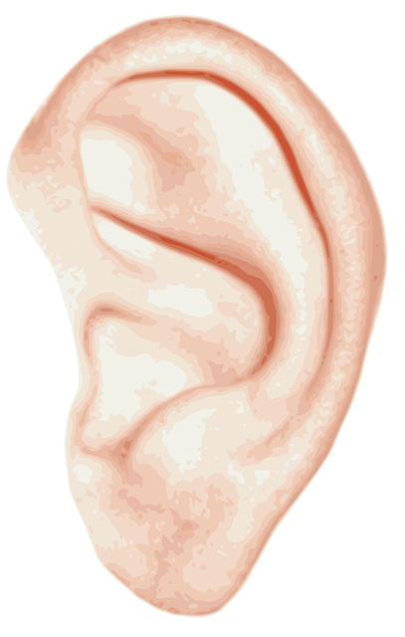
Expectations
A professional attitude is expected of you, in other words:
Punctuality: Your training supervisor's time is precious, and wasting it is a sign of disrespect.
No phone: outside working hours, even if you are allowed to keep your phone with you, don't use it! No hands in pockets and no phone in hands are the basics.
Listen to instructions: It's essential that you listen to and follow the instructions you're given. Don't hesitate to write them down in a small notebook.

Slide 9
Expectations
Ask questions: if in doubt, ask. A question is better than a mistake. If your question is pertinent and benevolent, never hesitate to ask. If you're interested in something and want to learn more, ask.
Accept low-value activities: Farming offers a wide variety of exciting activities, but let's not kid ourselves: there will always be less attractive things to do, and when you're just starting out, it's easier to start by sweeping than by ploughing a field.

Slide 10

Expectations
Gaining autonomy: You'll start with simple activities, and once you've mastered them, more complex ones should follow. But you may be asked to be autonomous, to have the same routine every morning when you arrive, for example. To do this, ask what you need to do autonomously, note down the activities in a notebook, the frequency of repetition, the order in which they need to be done, and little by little, gain autonomy in simple activities, such as cleaning, tidying up or whatever. Don't just sit back, observe, understand what's being asked of you and automate activities without risk.

Slide 11
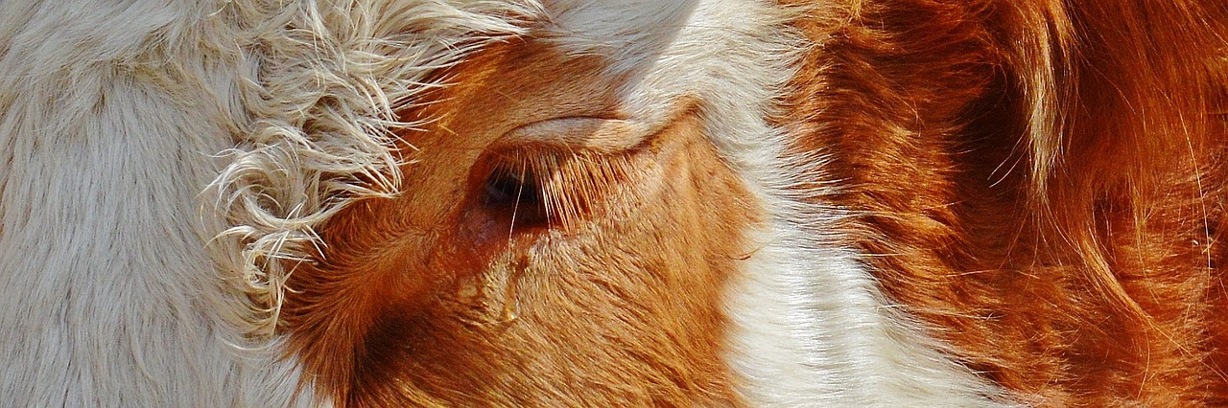
Expectations
Respect living things: working with living things, even for food, implies the utmost respect for them. You must respect the well-being and integrity of all humans and animals with whom you work.

Slide 12
Expectations
Expressing yourself: as seen above, we expect you to have a professional attitude, so express yourself:
  whether instructions are clear
  if you have to repeat
  if you are afraid to do something
  if you feel unwell
  if you want to learn more or have a particular wish
  if you have a physical weakness
  …
Be clear so that your supervisor can adapt his or her expectations to your abilities and wishes.

Slide 13
Safety rules
Respect safety rules: the agricultural environment can be dangerous and highly accident-prone. When you're just starting out, your attention is stretched by everything you have to understand and learn, so you're more tired, less attentive and less aware of the risks.
This makes it all the more important to pay attention to your surroundings and to safety rules. You must apply them to the letter. To do this, in addition to the instructions you're given, every company has a DUERP (Document Unique d'Evaluation of Risques Professionnels), available to employees.

Slide 14

Safety rules
DUERP: mandatory in all companies with at least one employee, this document summarizes the health and safety risks to which employees may be exposed. It includes :
  Inventory of hazards and results of risk assessment identified in the company.
  List of risk prevention and employee protection actions.
The employer is obliged to display it and make it available to employees.

Slide 15
Safety rules
Being aware of and respecting danger: we've just seen the DUERP, but what do you think the risks are in agriculture?
  mechanical: there are still far too many accidents involving farm machinery.
  physical: carrying a heavy load, an animal crushing a foot, a hand cut by a cutter when opening a bag, etc.
  chemical: phytosanitary products are forbidden to use without a diploma (certiphyto), and their storage and use are highly risky and regulated. The same applies to medicines. Cleaning products are also a source of danger, and precautions for their use must be strictly observed.
  microbiological: zoonoses are diseases that can be transmitted to humans by animals. They are closely monitored by health authorities.

Slide 16
Safety rules
Always wear PPE: PPE stands for Personal Protective Equipment. In agriculture they are:
  Safety shoes or boots.
  Gloves.
  overalls.
Don't touch a machine without authorization: some machines require a license, a medical examination or an authorization to operate issued following in-house training.

Slide 17

Advice
Politeness, respect and kindness
small notebook + pencil
change of clothes
sleep well
lunch + snacks
no telephone
no distribution of images or videos without permission
look after yourself and others
ask questions

Slide 18
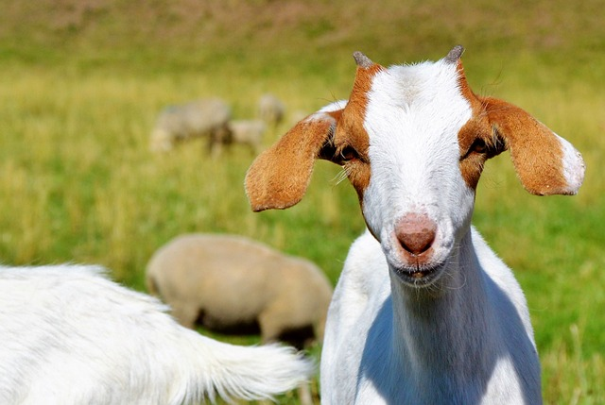
Thank you for the attention!

