Slide 1
Basics of agriculture
Exploring the Fundamentals of Agriculture 🌾 – Cultivating Knowledge from Seed to Harvest.

Slide 2
1. What is agriculture?
2. Agriculture in numbers
3. How does it affect our lives?
CONTENTS
4. The process of crop cultivation
5. Seasonality
6. Labelling
7. Policies and Regulations
8. Exercise

Slide 3
About this module
What are you going to find here?
Brief introduction to the concept of agriculture and how influences our lives?
Food needs and its relationship with agriculture.
The process of cultivation of crops and its link with the seasonality.
Understanding better what are the Quality and Origin Labels in agriculture.
Snapshot of the main Policies and regulations in Europe.
Dynamics, information, and resources related to agriculture.

Slide 4
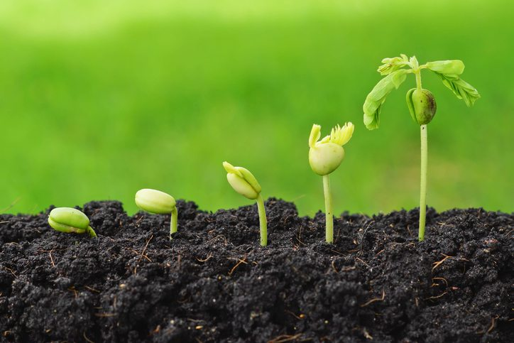
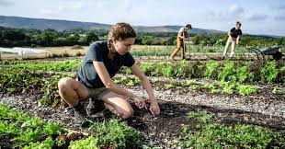
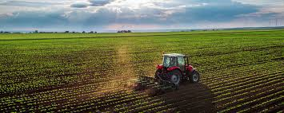
What is agriculture?
© European Union website
© The Ivey Centre for Building Sustainable Value (BSV)
© Confagricoltura
Agriculture refers to the scientific and professional field that is aimed at the production of food and products from natural resources.
This broad definition covers several different fields of expertise, including the cultivation of crops, animal husbandry, managed fisheries and, to some extent, the gathering of natural products.
The management of these natural resources is what makes agriculture so important to the development of the human race, as it is esteemed that unmanaged resources could only provide for less than 10% of the world population.

Slide 5
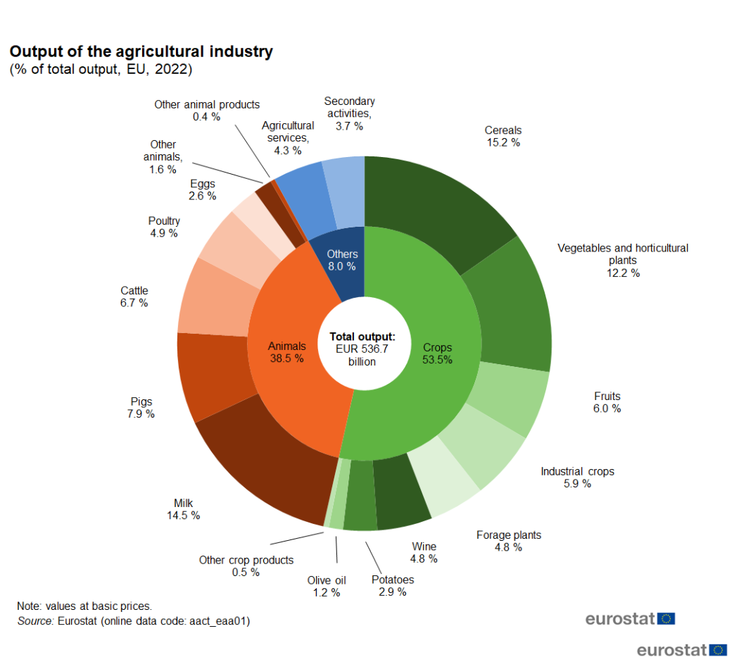
Agriculture in numbers
In 2022 agriculture accounted for almost 1,5% of European GDP, with an estimated value of outputs produced of 536.7 billions of euros.
This result was achieved through the work of more that 7,8 millions of full time workers, with an increase in salaries of more than 12% compared to 2021.

Slide 6
How does it affect our lives?
In modern world there is a prevalence of medium-to-large sized agricultural enterprises, which account for two thirds of the world food needs, while the small sized ones provide for the remaining third.
Both these models greatly affect the economical tissue of the rural areas and society, in terms of work and professional opportunities directly linked to cultivation and husbandry, along with all the professional profiles that are intertwined with the field (retail shops pesticides and phytosanitary, transportation and marketing).
From 2000 to 2020 we witnessed an astounding 55% increase in the production of primary crops commodities, followed by a steady increase over the years.

Slide 7
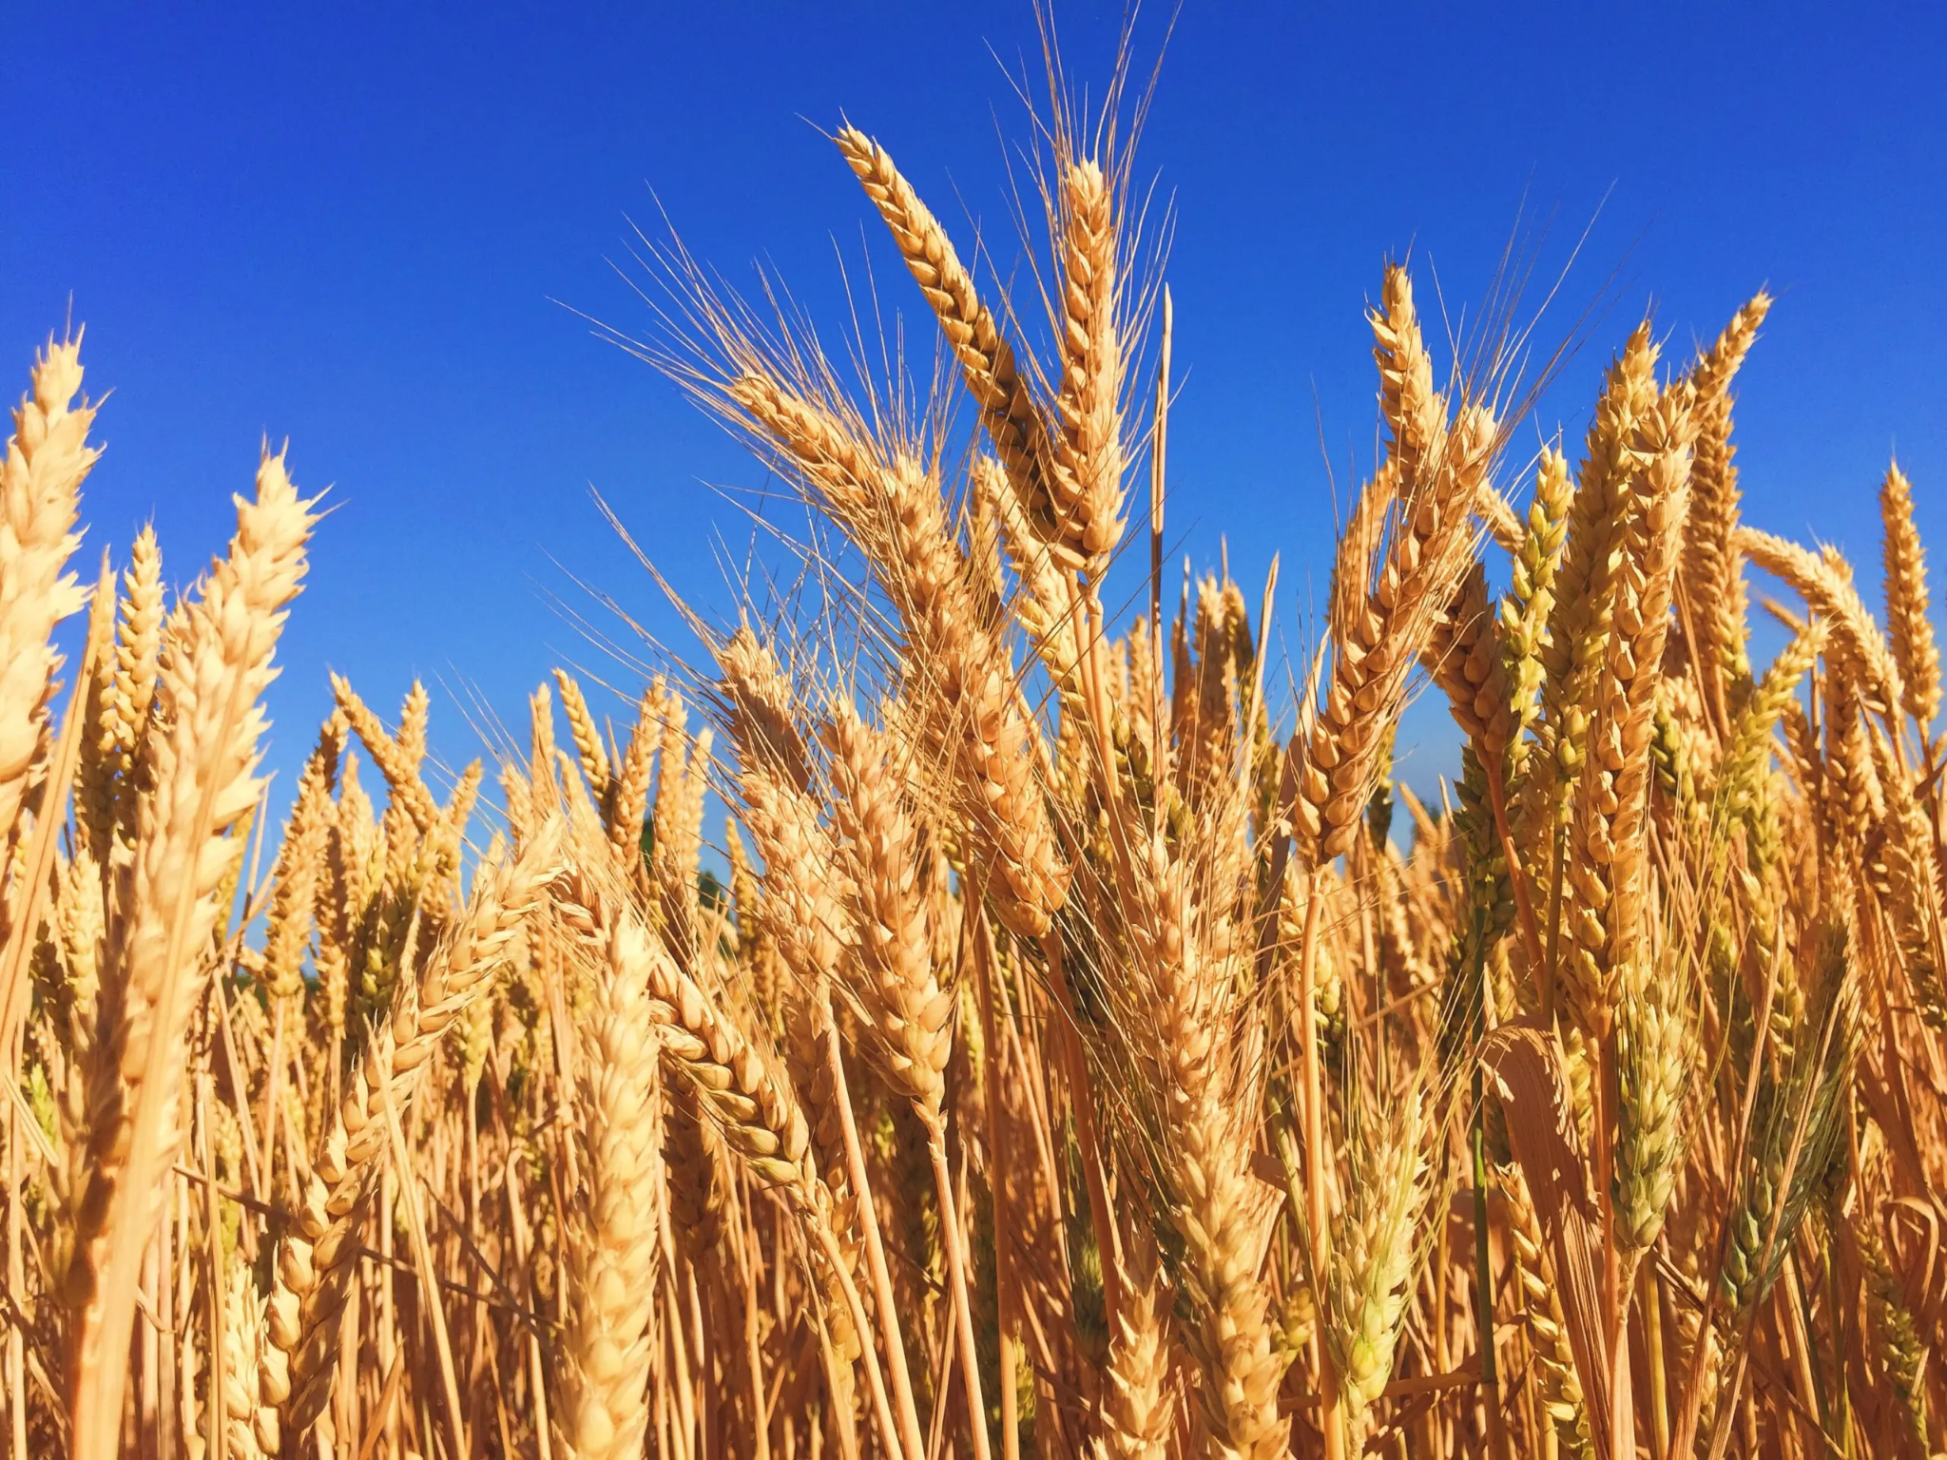
The role of cereals
Out of all the crops that we currently grow, the most impactful one is by far represented by cereals, which account for more that 50% of the food needs worldwide, while also being a major component of animals’ feeding.
For this reason, it is by far the most cultivated crop, reaching 32% of the total of cultivated crops, followed by sugar crops (22%) and vegetables and oil crops (12% each).
© Verdesian Life Sciences

Slide 8
Agriculture and food needs
The increasing population, along with a greater demand for food, are posing a great challenge on modern agriculture, which is actively seeking new ways to satisfy it.
Solutions are variegated and aimed at different aspects of the production chain, such as technological integration, plant breeding, expansion of the cultivable and livestock areas.

Slide 9
The process of crop cultivation
Cultivation of crops requires a strict application of different steps which must be followed to ensure the best possible crop yield over the course of the year.
These steps start from an accurate planning of the work to the plantation and the monitoring of the crops’ lifecycle, ending with the marketing and selling of the product.

Slide 10
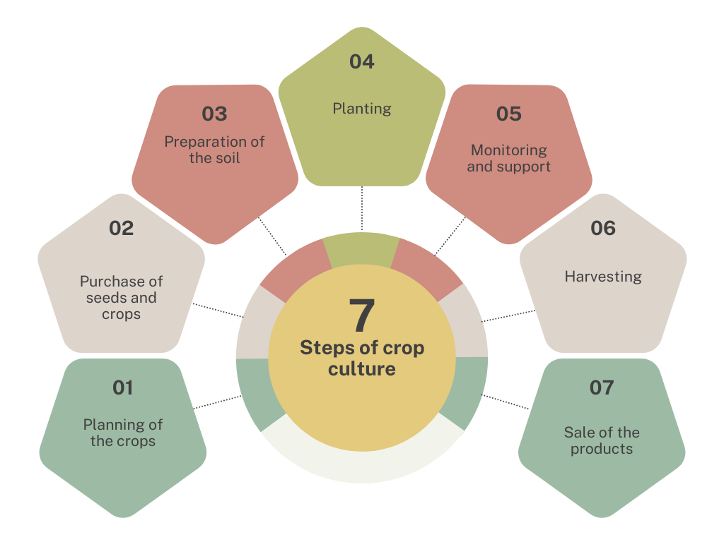
7 steps of crop culture
© PropAgri
Notes:
to share with partners for translation purposes

Slide 11
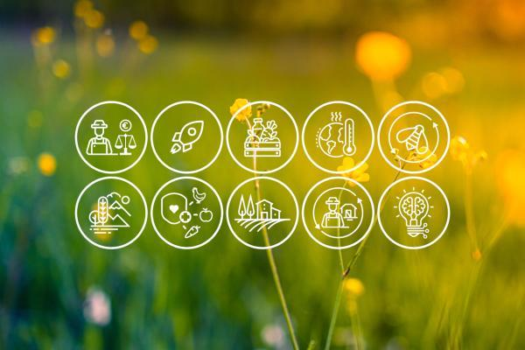
Step 1: Planning
The first and arguably the most important step to consider when working in modern agriculture consists in adequately planning in advance all the important aspects of our work.
This process starts with the selection of the crops that we want to plant, the methodologies and the techniques employed, the maintenance of the machinery, the employment of the necessary workforce.
Without sufficient preparation, we will surely encounter a great number of economic and logistic problems, which sometimes are too great to overcome when not properly accounted for.
© European Commission

Slide 12
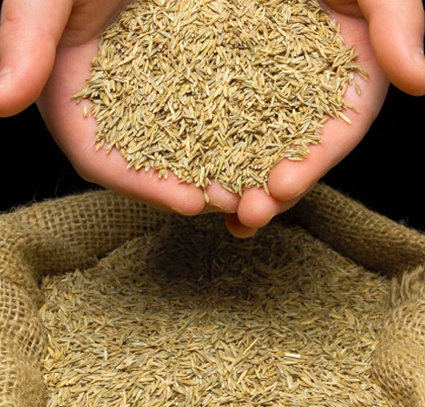
Step 2: Purchase of seeds and crops
Once we decided the type and amounts of crops that we plan to cultivate during a given season/year, we will have to purchase the right amount of seeds and seedlings that will ensure that the yield will be compatible with the expected results.
Different plantations yield different results, and therefore it is important to be properly informed on the difference between crops.
© Yardcare.com

Slide 13
Step 3: Preparation of the soil
Cultivations will decrease the soil fertility over time, which will damage further cultivation in the same area.
For this reason it is important to prepare the soil before every plantation. The process changes based on the specific needs of the crops that we are going to focus on (factors such as acidity of the soil, water requirements and type of soil), along with the types of crops that were previously planted on the same area (some plants impoverish the soil while other “fix” important nutrients).
Preparation of the soil usually consists in three stages:
ploughing;
leveling;
manuring and fertilizing.

Slide 14
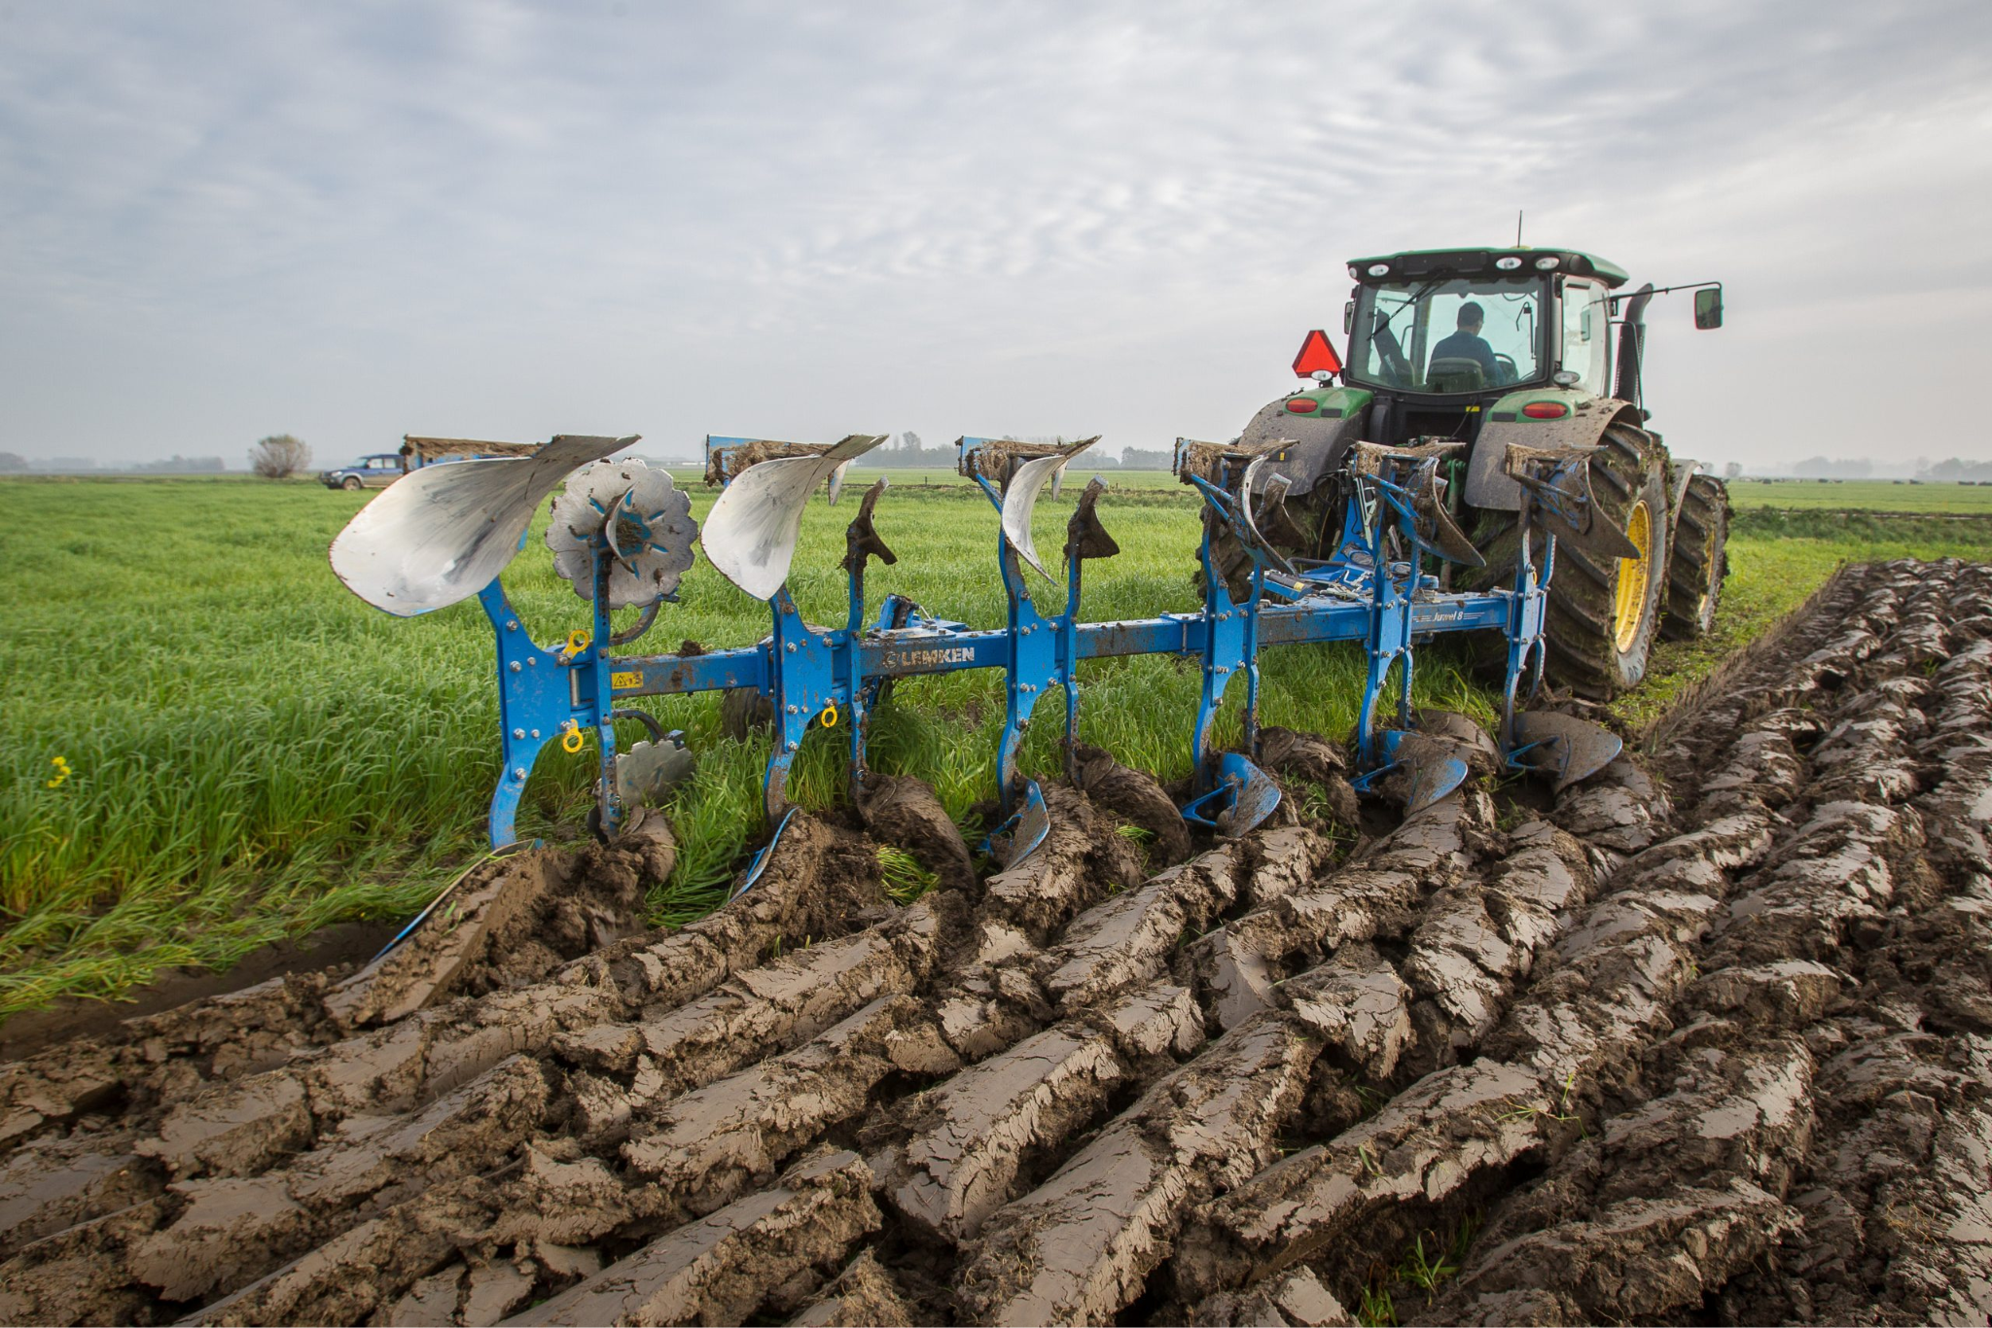
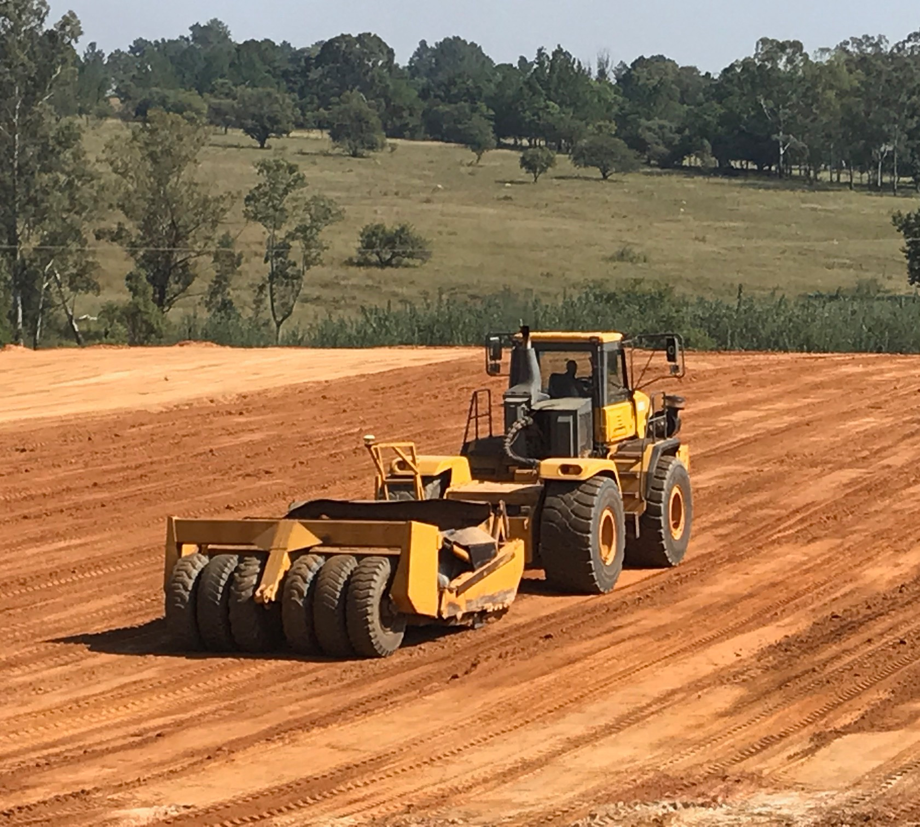
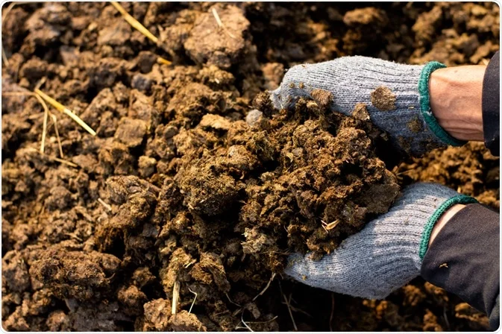
© Futurefarming.com
© jdhoffmanearthmoving.co.za
© azolifesciences.com
Ploughing
Leveling
Manuring

Slide 15
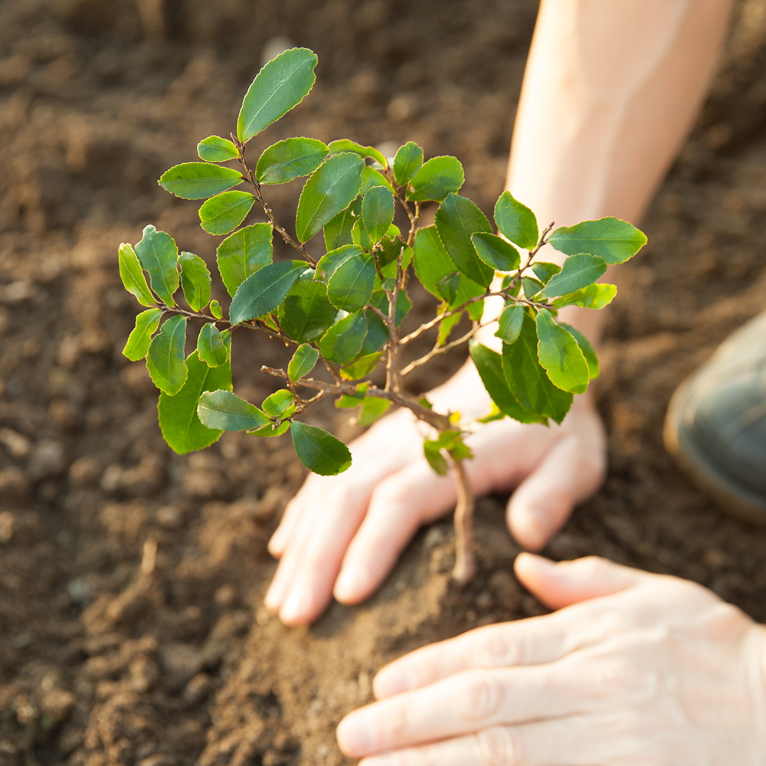
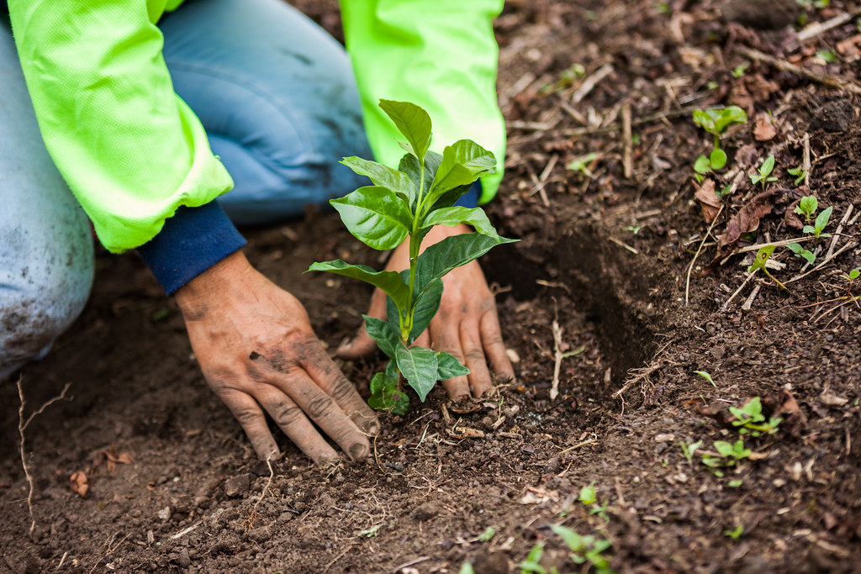
Step 4: Planting
The soil is now ready to house the crops, which can be planted mostly in two ways:
by sowing the seeds
by planting seedlings or mature plants.
These two different methodologies depends on the type of crop that we are going to cultivate, and on the strategy that we are going to adopt.
The first option is optimal to ensure the quality of the seed that we are going to use, while the latter is often faster and can be used to recover from delays in the workflow.
©cnr.ncsu.edu

Slide 16
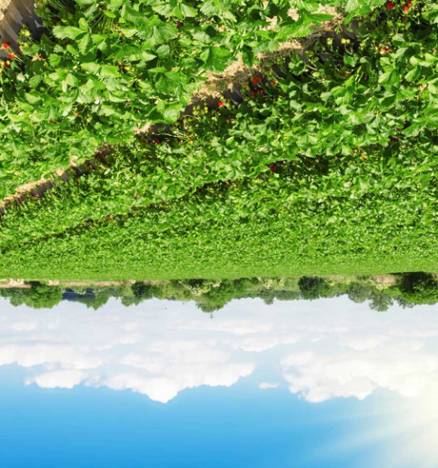
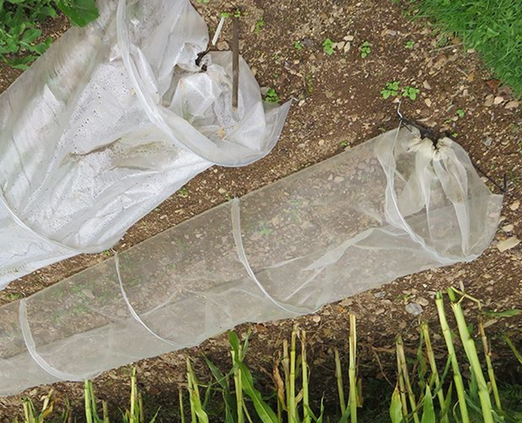
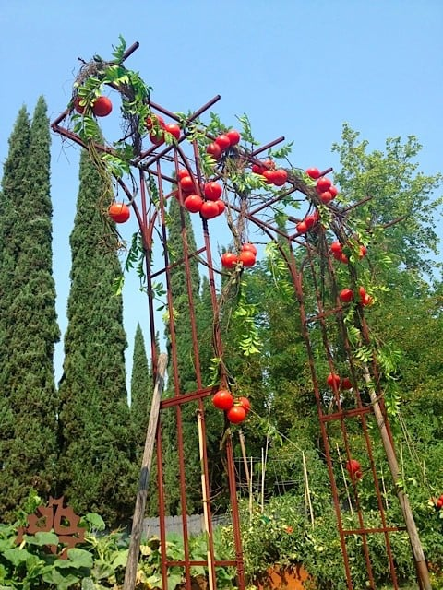
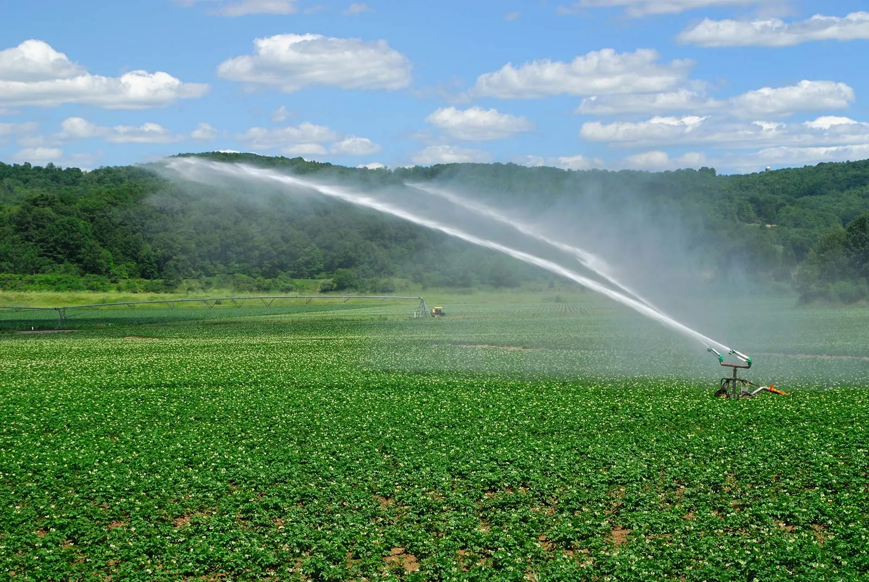
Step 5: Monitoring and maintaining crops
© fae-group.com
© rocketgardens.co.uk
The maintenance phase consists in giving the crops all the care that they need to produce the best possible harvest, both in qualitative and quantitative terms.
During this phase, we will have to provide the right amount to water, sunlight exposition, and provide protection from pests.
Moreover, in some cases, we will need to support the growth of the plant with specific tools (like trellis for tomatoes.)
© reluctantentertainer.com
© britannica.com

Slide 17
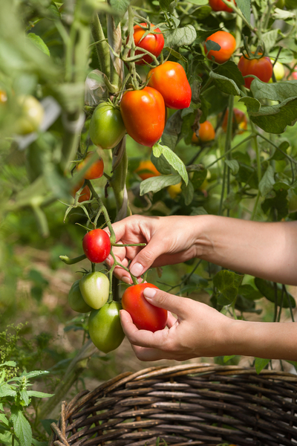
Step 6: The harvest
In the past, the harvest was considered the most intensive stage of the cultivation of crops.
Thanks to technological advance, this stage is now supported by a wide range of machinery and tools, that makes the process much less intense.
During this phase, the mature product is gathered and stocked in a way that makes it suitable to be sold or stored for the following seasons (as it is often the case for animal feed and cereals).
Depending on the crops cultivated, harvest is carried out in different ways, and within different timespans.
© thisismygarden.com

Slide 18
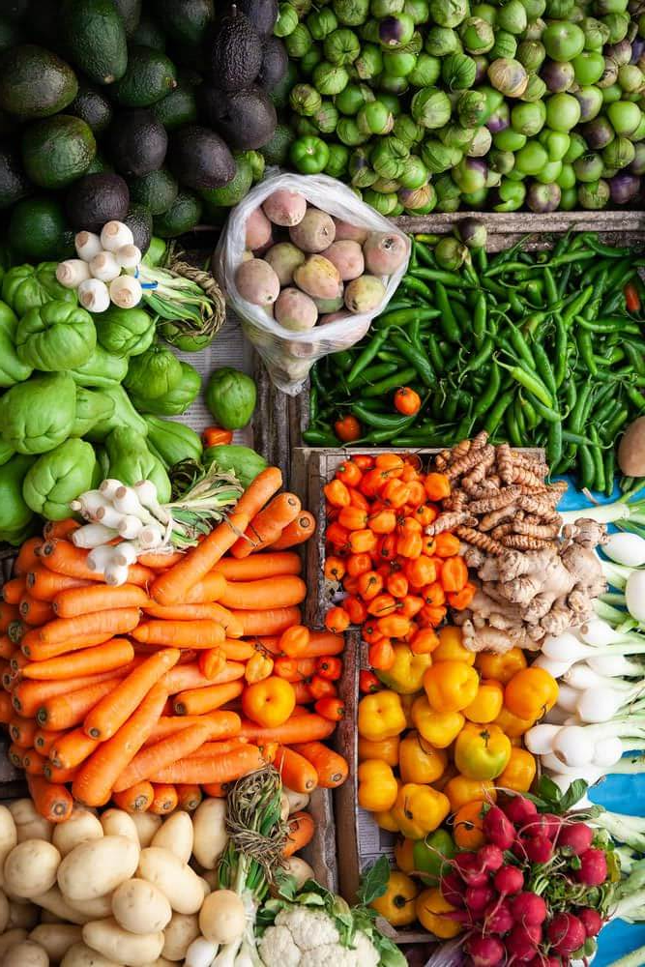
Step 7: Selling the product
The sale of the produce harvest each season can be carried out in two ways:
selling directly to the consumer, an approach that is mostly employed by small farmers and producers.
selling to other distributors, that will then sell the produce to markets, restaurants or export towards other countries.
© okcredit.in

Slide 19
Seasonality
Seasonality represents the basis on which we can properly plan our yearly work in agriculture, regardless on the type of crop or livestock that we are planning to work with.
Different seasons come with different stages of the work, as they influence the times for sowing the seeds of the crops, the harvests, the periods in which animals are born, etc…
Nowadays the effect of seasons can be mitigated by methodologies such as greenhouses planting, or the employing of hydroponic and aeroponic technologies, which allows for a greater degree of freedom.
Seasonality also affects the prices of the crops and products sold, as the relationship between offer and demand changes over the year.

Slide 20
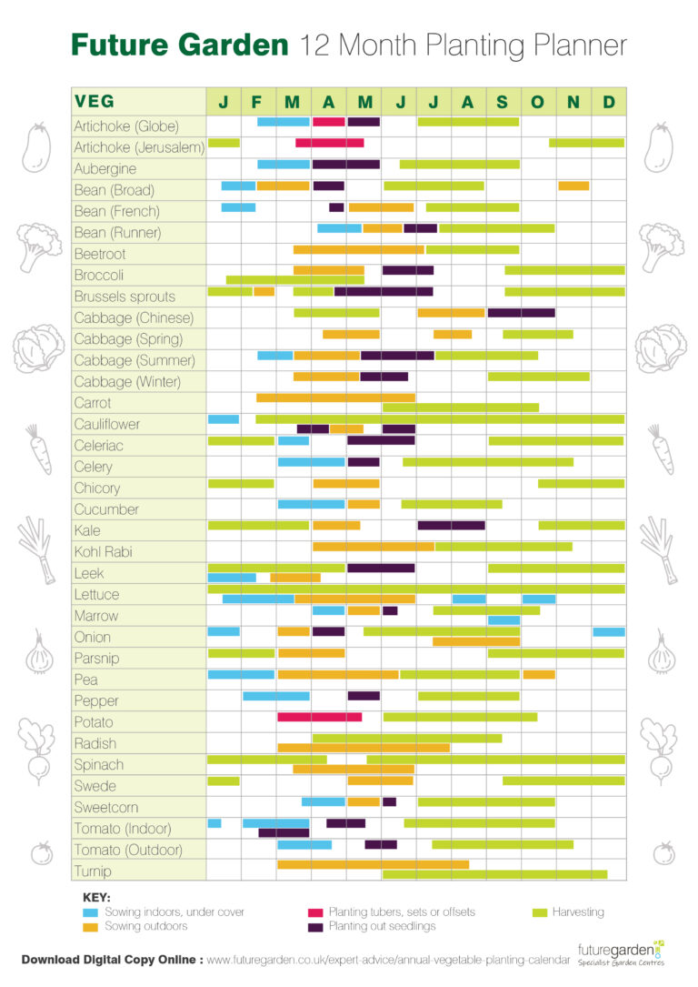
©f uturegarden.co.uk

Slide 21

Labelling
Labels play a big role in the field of agriculture, as it allows to provide consumers with a warrant of quality.
By satisfying specific requirements, produce can be awarded with one or more quality labels, which can increase its attractiveness.
These requirements can be linked to the produce in itself, the place it’s been grown or the methodologies employed in its production.
© eufic.org

Slide 22
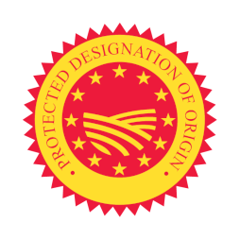


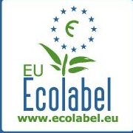

European labels in agriculture
Origin labelling
Geographical Indication (GI) labels are given to products with specific attributes, qualities or reputation stemming from their geographical origin. It comprises:
PDO – protected designation of origin (food and wine)
PGI – protected geographical indication (food and wine)
GI – geographical indication (spirit drinks).
EU Ecolabel
It is awarded to products to minimise their environmental impacts over their entire lifecycle, while guaranteeing
their high quality.
© European Commission
EU Organic Label
The Organic label certifies that the products have fulfilled strict conditions on how they were produced, processed, transported and stored. The logo can only be used on products when they contain at least 95% organic ingredients and additionally, respect further strict conditions for the remaining 5%.
© European Commission
© European Commission

Slide 23

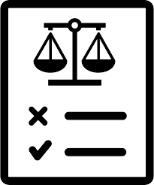
Policies and Regulations
©f laticon.com
Agricultural activities are often influenced by government
policies and regulations related to land use, water rights,
subsidies, and environmental protection. Farmers need to be
aware of and comply with these regulations.
Moreover, many national and international entities
(EU) provide farmers with resources and financing, which can
prove invaluable especially when moving the first steps in the
field.
© uxwing.com

Slide 24
A Policy example: Common Agricultural Policy (CAP)
The Common Agricultural Policy (CAP) is a great example of a legislation that regulates agriculture to support and protect professionals in the field and consumers, with a special attention to climate change.
This objective is achieved through a joint intervention of:
income support to farmers and other professionals in the field.
market measures in difficult market situations (scarcity or oversupply of product).
rural development measures.

Slide 25
What’s in the next module?
Introduction to climate change
The link between agriculture and climate change
Causes and solutions
Challenges for the agriculture of the future
Potential for innovation and development

Slide 26
Exercise “Vision board- my model of agriculture
Creating a “Vision Board” of your model of agriculture
Material needed:
Old magazines, newspapers, brochures etc.
Flip Charts
Scissors and Glue
*** For an online version, use digital tools such as Canva and search for “moodboard” or “vision board” templates.
Aim
A vision board i's a visual representation of your goals and aspirations. It is a collage but with purpose. When complete, it serves as an inspiring visual reminder of you're aiming to accomplish.
Method and explanation:
Ask participants to brainstorm and customize their vision board by combining photos and graphic material (or the one available on the platforms).
Give them 30 minutes to finalize the task.
Ask everyone to share their model.
At the end of the presentations, run a short debriefing asking the participants about the activity.

Slide 27
Thank you for the attention!

