Slide 1
Ecology and sustainable development in agriculture
PROGRAMME ERASMUS+
Project ID KA220-YOU-37C49185
Cooperation partnerships in youth Form

Slide 2
Introduction
Ecology is the science that studies the interactions of living beings (biocenosis) with each other and with their environment (biotope). All living beings, their environment and the relationships they maintain form an ecosystem.
When we think of ecology in agriculture, we immediately think of organic farming.
But did you know that the reality in the field is far more complex and fascinating?

Slide 3
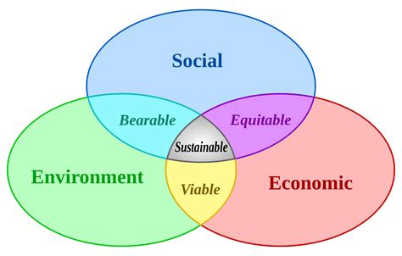
Sustainable development is an improvement in society's performance that takes account of environmental, social and economic constraints, so as to be viable in the long term.
Sustainable development is "development that meets the needs of the present without compromising the ability of future generations to meet their own needs", Mrs Gro Harlem Brundtland, Norwegian Prime Minister (1987).

Slide 4
In nature, everything is interconnected. Life is the sum of incalculable interactions within an ecosystem. And we know today that if the balance of our ecosystems depends on our production methods, our agriculture depends even more on this balance. Awareness of this link has changed our expectations and farming practices.
Farmers are not only the guarantors of the quality of our food and our food self-sufficiency. They are also the guardians of nature, the creators of our rural landscape and the protectors of our biodiversity.

Slide 5
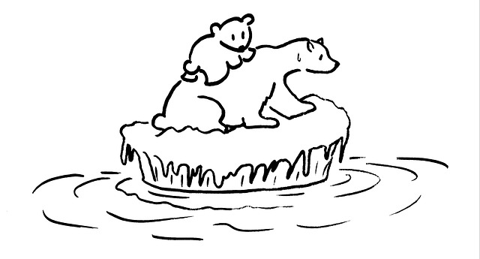
The climate emergency
With climate change and the disappearance of certain species, the need for mankind to adapt its modes of production and consumption is becoming more than a reality - it's an emergency.
To achieve this, farmers, industrialists and politicians are on the front line. The impact of their choices and practices on nature and our health is enormous.
What's your view on the subject?

Slide 6
The climate emergency
With droughts, floods and temperature changes having a huge impact on plants and animals, the disappearance of certain natural enemies and the appearance of new predators, farmers find themselves on the front line of climate change.
Each variation has an impact on their activities and their future.
As the prices of products and raw materials are globalized, a drought on the other side of the world leading to a drop in corn yield results in a rise in its price across the globe.

Slide 7
The evolution of agriculture
The agricultural world needs to evolve fast if it is to produce enough while respecting nature and mankind.
The old image of agriculture needs to be revised. Today's farmers work with increasingly sophisticated tools, but also with a growing knowledge of nature and awareness of their impact on it.
Respect for biodiversity, nature and its cycle has become normal. It has even become compulsory to obtain certain Common Agricultural Policy (CAP) subsidies.

Slide 8
The evolution of agriculture
Pesticide use is increasingly limited, and treatments are localized. Thanks to new technologies, we can target each plant individually, to determine which ones need treatment or fertilizer.
Tractors are linked by GPS to satellites, which can see in real time the areas of deficiency in a field. The spreader is directly linked to the on-board computer, which automatically triggers and adjusts its flow rate according to the plants' needs.

Slide 9
The evolution of agriculture: Europe
Europe, through its Green Pact, plans to reduce its emissions by 2030:
_ 55% in CO2 emissions
_ 50% of pesticides used
and increase organic farming to a quarter of cultivated land.
To achieve this, an increase in CAP subsidies and a change in its allocation system have been put in place.
But do you know exactly what the CAP is?
le Pacte vert prévoit que l'UE réduise ses émissions de CO2 de 55 % d'ici 2030 − et l'objectif de baisse de 50% des pesticides d'ici 2030, avec un quart des terres réservées au bio.

Slide 10
The evolution of agriculture: the CAP
The CAP is a common agricultural policy for all European Union countries.
Created in 1962, its aim is to modernize agriculture, regulate prices and agricultural production, and avoid excess production or the risk of famine.
Its role is crucial, and its subsidies, on which many farmers depend, are conditional. Nearly a third of the CAP's 387 billion budget will be used for "green payments", awarded to farmers in exchange for environmentally-friendly practices, such as crop variation, permanent grassland, respect for wetlands, creation and maintenance of hedgerows...

Slide 11
The evolution of agriculture: agroecology
Agroecology means taking into account the functioning of the ecosystem in our farming system.
An ecosystem is a biotope (everything non-living: pH, temperature, soil composition, etc.) and a biocenosis (everything living: bacteria, animals, plants, etc.) in a given system.
All the elements of an ecosystem interact with each other, and pH and temperature determine which plants will or won't grow. These plants will attract or repel insects and animals.

Slide 12
The evolution of agriculture: agroecology
Agroecology encourages the right interactions to limit human action and promote ecosystem balance.
For example, attracting beneficial insects, the natural predators of crop pests. This limits the use of chemical products.
Or planting a cover crop in winter to trap nitrogen in the soil, thus avoiding contamination of our water, and storing it for the next crop. This cover will also have an impact on soil structure, limiting the amount of work required to preserve the life it supports.
Qu'est-ce que l'agroécologie? - YouTube (2 min)

Slide 13

Knowledge of living things
Do you think we need diversity in agriculture and why?
Are microbes (especially bacteria and fungi) useful or problematic in agriculture?
Agriculture et biodiversité : cultivons avec la nature (2021) - YouTube (7 min)

Slide 14
Knowledge of living things
As in humans, bacteria and fungi can cause illness, however some are also our best allies. Humans could not live without their intestinal bacteria, and ruminants can only digest grass thanks to specific bacteria, protozoa and fungi.
In the case of plants, symbiosis with a fungus can increase root capacity a thousand-fold, thus limiting the need for fertilizers and making plants more resistant to drought. But this microbial life is very fragile and sensitive to variations. To help it develop, new techniques known as soil conservation, such as no-till farming, are increasingly being developed.

Slide 15
Knowledge of living things
In nature, everything is linked and balanced. The quality of the soil will determine the quantity of bacteria, fungi, earthworms and so on.
To enable a living being to grow in the best possible conditions, we must first understand what it needs, its impact on its environment and all the environmental factors that will help or hinder its growth.
Agriculture is a highly specialized field, where to be competent you need to know and master an enormous amount of knowledge, from adjusting tire pressure so as not to compact the soil too much, to fermenting your corn so that it is better digested by cattle, to regulating the pH of your soil to encourage microbial life,to respect nature, you have to understand it.

Slide 16

Organic innovation
From the selection of new varieties better adapted to climate change, plant associations and agroforestry, organic innovations are varied and booming.
What is agroforestry? It consists of the associating trees with crops and livestock, to the creation of natural fertilizers based on bacteria and mycorrhizae, the use of bacteria, fungi, viruses, insects and others to replace pesticides and new practices,
Comment nourrir la France de 2050 sans engrais chimiques ? - YouTube (10 min)

Slide 17
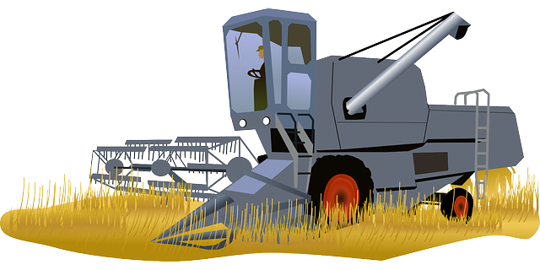
Technological innovation
What do you think is the current state of technological innovation?
The same innovations can be found in agriculture as elsewhere. From milking robots that allow cows to give milk whenever they want, to tractors connected to on-board computers and GPS, new techniques are constantly making agriculture more efficient and comfortable for people.
Agriculture connectée : les fermes s'automatisent grâce aux innovations technologiques - YouTube (6 min)
La technologie, l'alliée d'une agriculture performante et durable - YouTube (4 min)

Slide 18
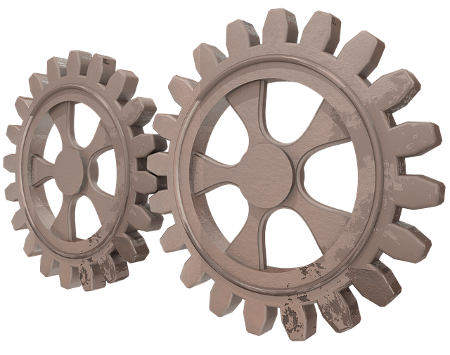
Innovation
Agridata and digital technology:
Thanks to nano-sensors and satellites, numerous data are analyzed, such as water requirements or deficiencies, and the presence of viruses, parasites or weeds. All this is done down to the last millimetre, to ensure the best possible adaptation of the solution and minimize the use of inputs (water, fertilizers, phytosanitary products).
Biocontrol:
To further limit the use of traditional phytopharmaceutical products (chemical pesticides and herbicides), we are increasingly using molecules derived from living, natural mechanisms and even living beings such as bacteria or ladybird releases in fields to combat aphids.

Slide 19
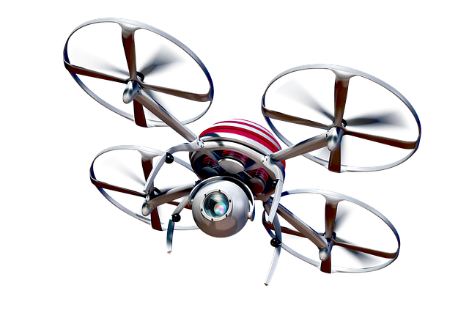
Innovation
Robotics:
From milking robots in dairy farming and weeding robots in market gardening to scraping robots that clean corridors, robotics and drones, robotics is everywhere. It saves time and effort. Combined with digital technology and agridata, it offers the possibility of precision agriculture, more respectful of men, animals, plants and nature.
Technologie : des drones au service des agriculteurs - hi-tech - YouTube (2 min)

Slide 20
Changes in practice
In addition to agroecology, agroforestry and other new practices we've already mentioned, animal welfare has become a priority in recent years, with innovations and legislation helping producers to make positive changes to their practices.
Tomorrow's agriculture is being built today, and it's evolving rapidly, with positive changes in our vision of the living world and in farming practices.

Slide 21
Animal welfare
In 2018, ANSES proposed a definition of animal welfare as "an individual positive mental state related to the satisfaction of behavioral and physiological needs such as food or health. This state varies according to the animal's perception of the situation".
In 1992, the Farm Welfare Animal Council defined the 5 freedoms of the animal:
1-No hunger or thirst
2-No discomfort
3-No pain, injury or illness
4-No fear or distress
5-To be able to express the natural behaviors of the species.

Slide 22
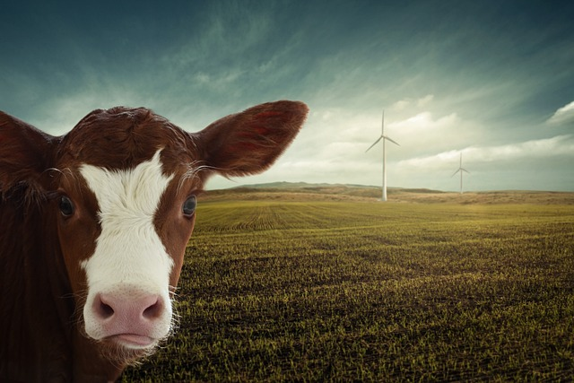
Welfare: for animals and farmers
The well-being of farmers will depend on more factors than that of the animals, what do you think a farmer needs to feel good?
Health of course, social and economic success, leisure, self-realisation, harmony with oneself and with others, a sense of achievement and usefulness, but also the recognition of others for the efforts and sometimes even the sacrifices made to produce ever more, ever better.

Slide 23
Welfare: for animals and farmers
This well-being is very important, and starts with respect. Respect for both the animal and the farmer.
Animal welfare is increasingly demanded by consumers and the authorities, but let's not forget the welfare of farmers, who have accepted sometimes hard working and living conditions in order to provide for the consumers most basic needs. They are necessary to society, their knowledge is invaluable and their role more important than we could imagine.

Slide 24
Labels
Do you know what labels are for?
To certify the quality of our products and recognize the work of our farmers, we offer a range of labels, some better known than others.
Which labels do you know?
Do you know what they mean and represent?

Slide 25
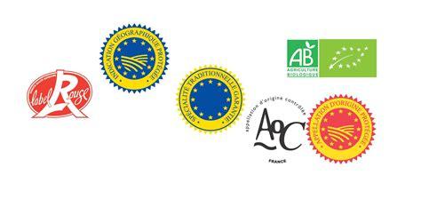
Labels: some examples
AOP: Protected Designation of Origin, designates a product in which all stages of production are carried out according to recognized know-how in the same geographical area, which gives the product its characteristics.
PGI: Protected Geographical Indication. This is a European label guaranteeing the place of production, elaboration and transformation of the product.
AB: Agriculture Biologique (Organic Farming), an organic product with strict specifications guaranteeing respect for biodiversity and natural resources.

Slide 26
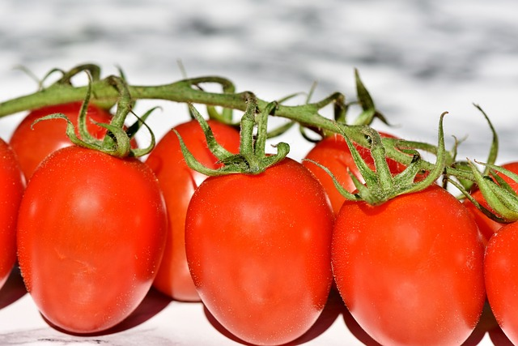
Saveol and pesticide-free
Saveol, France's leading tomato grower, was a pioneer in biocontrol and pesticide-free production.
Pesticide-free tomatoes are:
Means: no synthetic pesticide treatment from flower to plate by our market gardeners, and close health monitoring by a team of specialized technicians.
Results: no quantifiable pesticide residues on tomatoes.
Controls: regular analyses by an independent laboratory.
https://youtu.be/75u_5BHYqa8 (1 min)

Slide 27
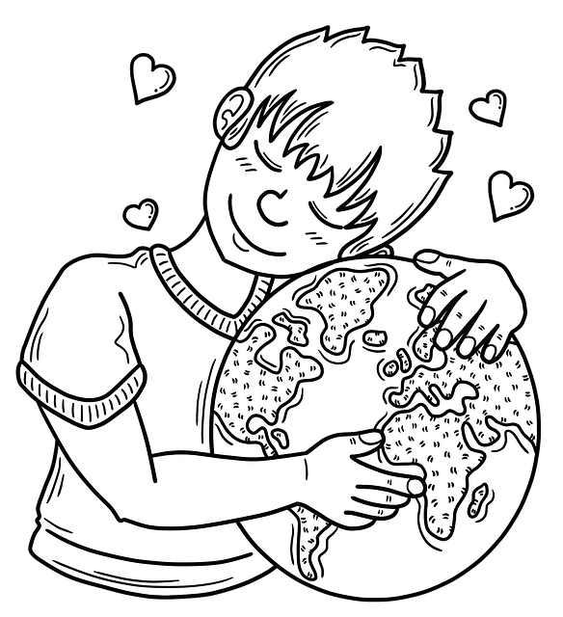
What's it for?
What do you think are the main reasons for all these innovations and developments in agriculture?
Why does ecology play such an important role, even on conventional (non-organic) farms?

Slide 28
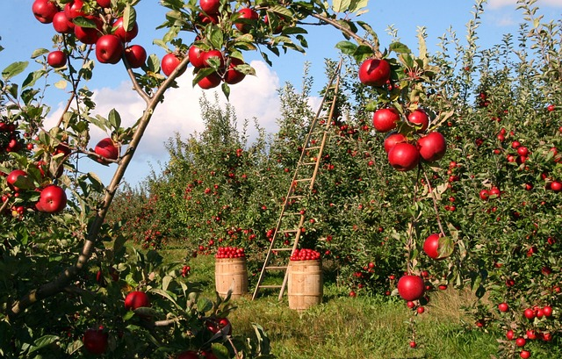
Thank you for your attention

